Slide 1



Instabilities in the linear plasma device MISTRAL
A. Escarguel, Y. Camenen, N. Claire, and F. Doveil
ASTRO
Opération XPM
PhDs :
C. Rebont (07/2010)
S. Jaeger (10/2010)
T. Lefèvre ( 02/2012)
P. David ( 02/2017)
and post-doc. :
R. Baude (since 2015)

Slide 2
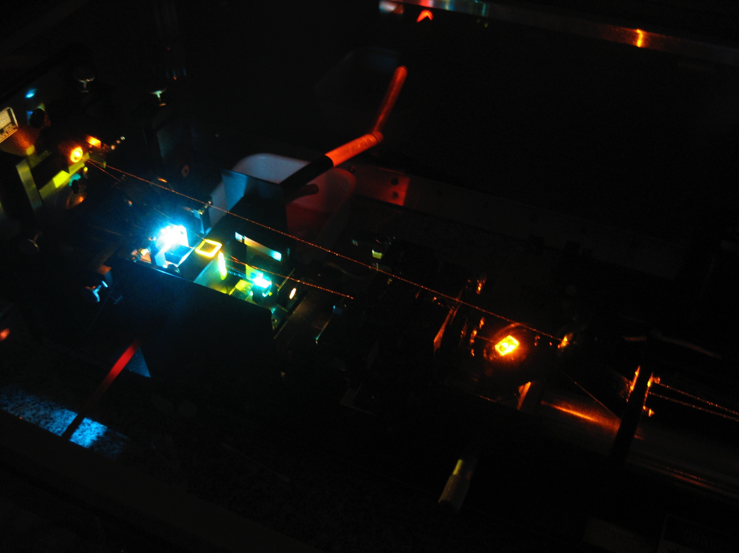
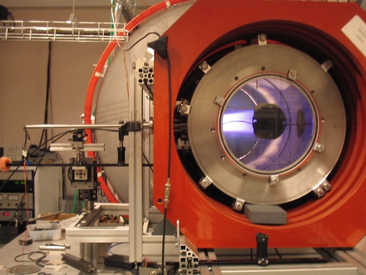
MISTRAL
  Toward non-intrusive diagnostics
  Laser Induced Fluorescence (LIF) for ion motion
  Tomography for plasma instabilities
  (Spectro-tomography for Tokamak SOL and cold plasmas
  EFILE : electric field measurement in a plasma)
ASTRO
Opération XPM
Dye Laser (LIF)
MISTRAL experiment
Notes:
Sondes de Langmuir
Caméras rapides
Diagnostic micro-ondes de n_e
Spectroscopie…

Slide 3
Plasma column instabilities in ExB fields:
experimental study in MISTRAL experiment
ASTRO
Opération XPM
Notes:
Transport « anormal » = non collisionnel
Propulseurs plasma à effet Hall : le transport anormal réduit le confinement des électrons → réduction de l’efficacité du propulseur

Slide 4
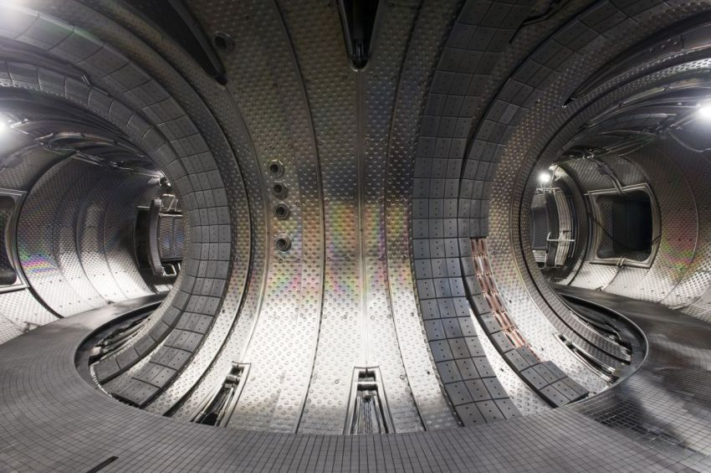
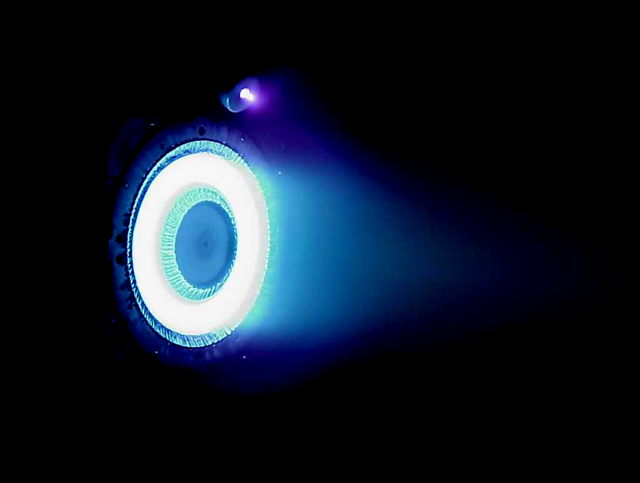
Plasma instabilities in ExB fields
ASTRO
Plasmas in ExB fields:
Plasma thrusters
Magnetron discharges
Penning gauges…
Charged particles drift in E x B direction.
Interesting when azimuthal drift
→ But configuration undermining development of « anomalous » transport of electrons across B (Tokamak fusion problem, favorable in plasma thrusters).
Opération XPM
Notes:
Transport « anormal » = non collisionnel
Propulseurs plasma à effet Hall : le transport anormal réduit le confinement des électrons → réduction de l’efficacité du propulseur

Slide 5
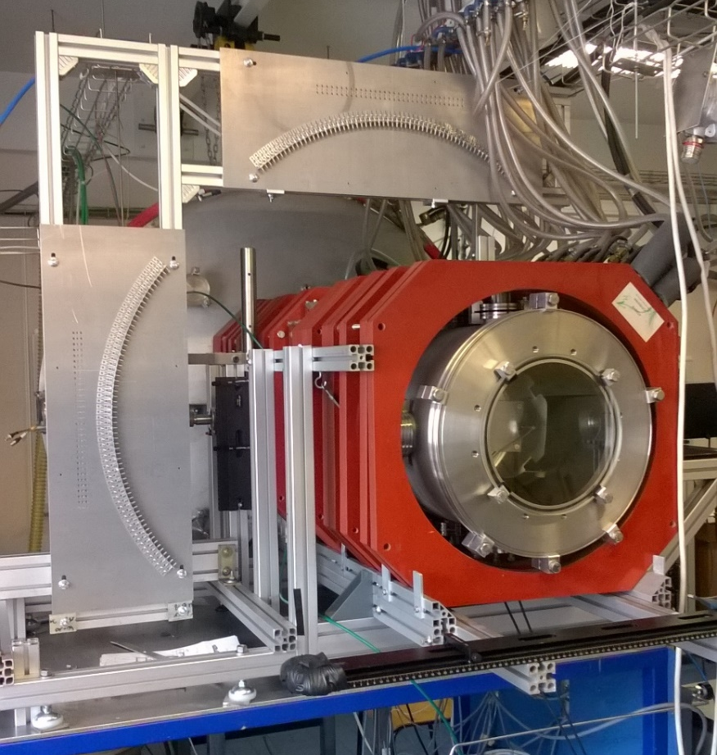
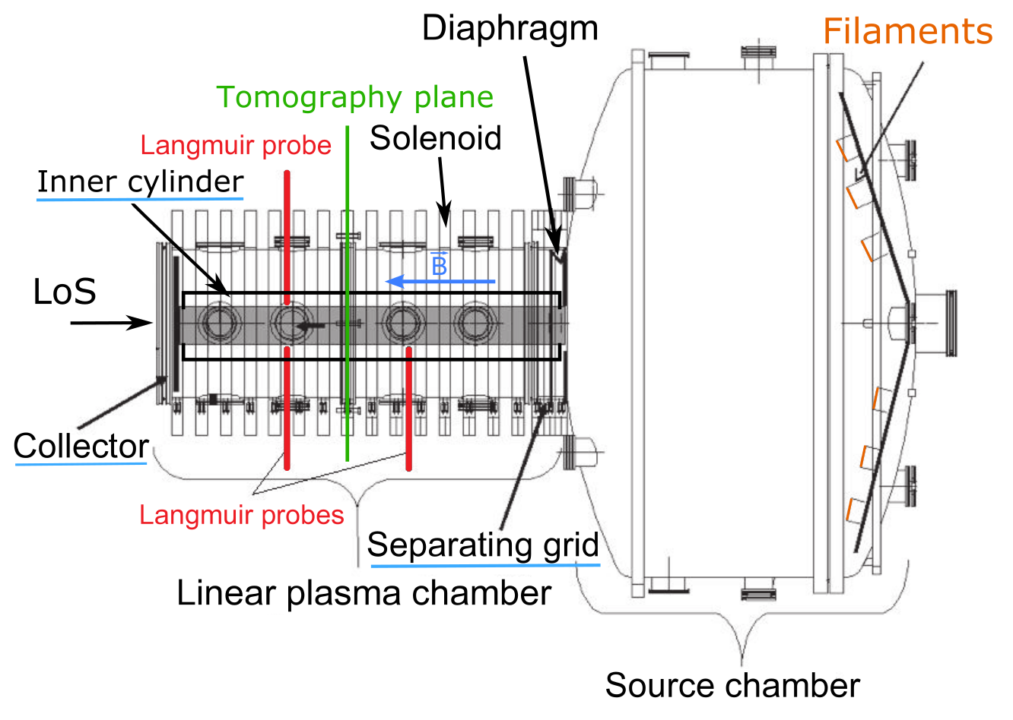
MISTRAL experiment
Machine built by G. Leclert and Th. Pierre in 2000
Weakly ionized ions → specific instabilities
Presence of ionizing (primary) electrons
ASTRO
Opération XPM
L = 1.2m
Radius : 4.10⁻² m
1.10⁻⁴ mbar < P_{Ar} < 1.10⁻² mbar
B < 25 mT
1 eV < T_{e} < 4 eV
10¹⁴ m⁻³ < N_{e} < 10¹⁶ m⁻³
Toulouse 21-23 June 2017
Notes:
Paramètre Ro star = rayon de Larmor ionique / rayon plasma
E(radial): 100 V/m
significantly influence turbulence characteristics: in usual laboratory devices,
ro* is of the order of 10-1 → global modes (large fluctuation, low mode number of the order of unity, weakly developed turbulence) are observed
in large facilities, with ro*~10-3 → local modes are observed (large mode number m~100 nonlinearly coupled yielding strong turbulence
DIAGNOSTICS :
Sondes de Langmuir
Caméras rapides
Diagnostic micro-ondes de n_e
Spectroscopie…

Slide 6
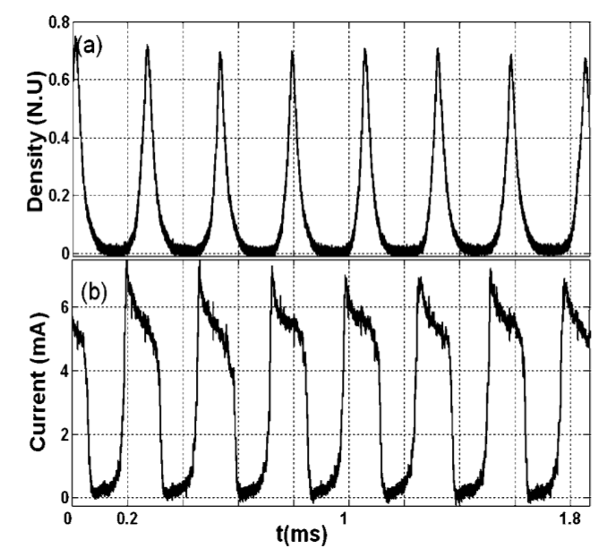
Regular modes rotating around plasma column
Langmuir probe in the diaphragm shadow : n_{e}.
2 half-cylinders around the column : radial current I.
→ Observation of rotating structures (ν = a few kHz)
½ cylinder
source
[Jaeger POP 2009]
probe
Notes:
On peut conserver ces structures pendant 1 ou 2 heures!

Slide 7
Analytical model for the rotation frequency
of regular modes
Quasi-neutral plasma in diaphragm shadow,
Regular rotation around central plasma : v_{iφ} = ω.r,
Ionization neglected in diaphragm shadow,
Ions loose energy through collisions with neutral atoms,
Collisionless electrons,
Cylindrical symetry.
→ Simple system:
v_{S} = v_{er} – v_{ir},
ω_{L} = eB/M,
λ_{fi} = ion mean free path.
[Annaratone et al. POP 2011]
Notes:
Termes convectifs ioniques : les 3 termes en v_ir et r
Termes de friction ions/neutres : les 2 termes en raçine
Terme force B : terme en wL.

Slide 8
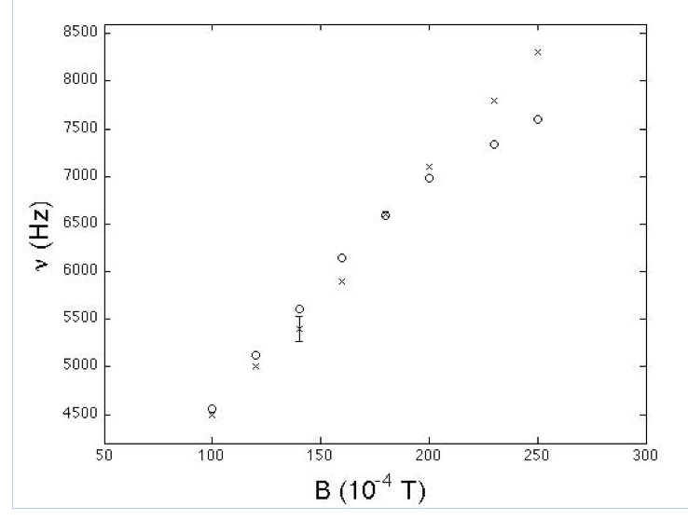
Rotation frequency ν versus magnetic field
o : model
X : exp.

Slide 9
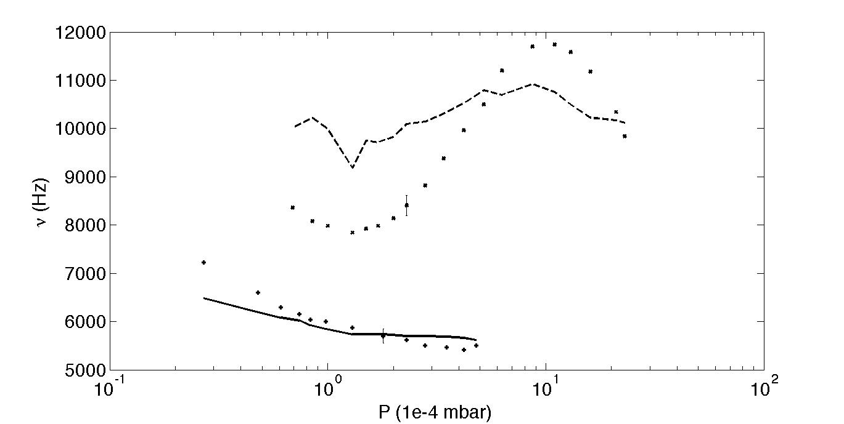
Rotation frequency versus Pressure
B=180G : x (exp.) ; -- (th.)
Simple physical model explaining ν global behavior
B=100G : + (exp.) ; - (th.)
[Annaratone POP 2011]
Notes:
Comment se traduit la variation de la fréquence en fct de P ? par la dépendance de lambda_fi inversement proportionelle à n_neutres

Slide 10
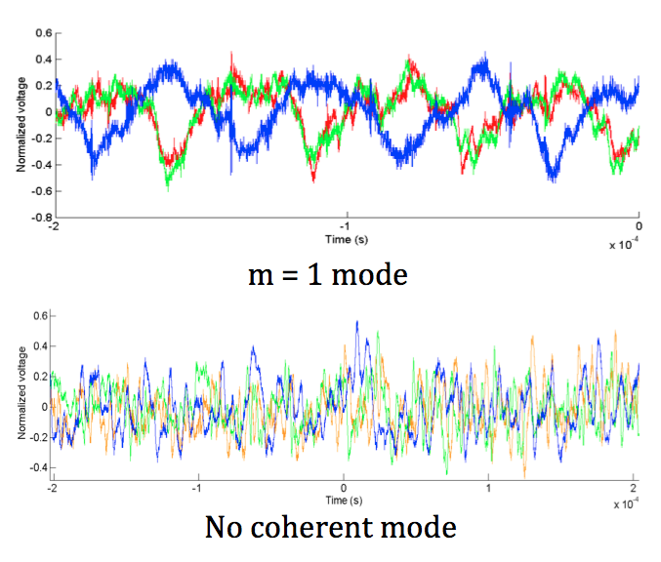
Low frequency instabilities : looking for symetries…
Flute regular modes
No symetry for « turbulent » plasma
probe
source
column
probes

Slide 11
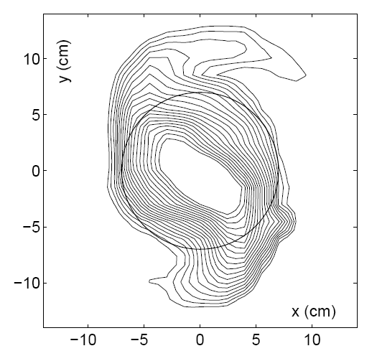
Low frequency instabilities : Langmuir probes
n_{e} probe measurement in a plane ┴ B
Probe measurements
Perturb the plasma (sonification)
Long measuring time > 1 h
Strong hypothesis on symetry
→ optical measurements ?
source
colonne
: measurement plane
[Matsukuma et al. Phys. Lett. A 2003]

Slide 12
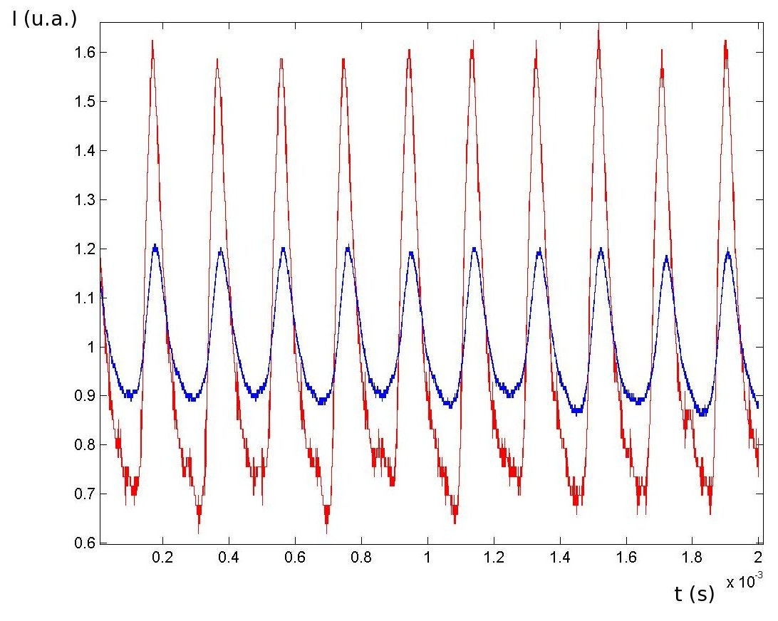
Low frequency instabilities : possible optical measurements…
Strong correlation between probe and photo-diode signals
- : probe polarized at
V > V_{plasma}
- : photo-diode
(collimated los)
source
los
Photod.
column
probe

Slide 13
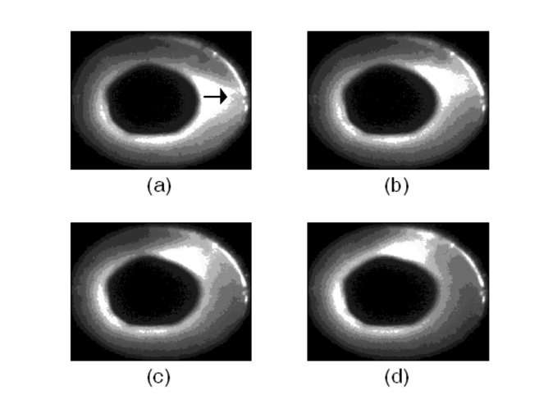
Low frequency instabilities : intensified camera
Caracteristics : Δt_{min} = 1 ns ; ν_{acq} = 25 Hz ; 736x572 pixels
Periodic phenomenon: intensified camera synchronized with probe
Plasma symetry hypothesis
Instabilities in diaphragm shadow : azimutal modes m=1 (1 spiral arm), 2 (2 spiral arms), turbulence
source
camera
column
probe
[Escarguel EPJD 2012]
Notes:
m = r x k_teta
Donc, si m=2, alors 2 x lambda_teta = 2 x Pi x r
Donc, on a 2 fois la longueur d’onde azimutale en tournant autour de la colonne centrale.

Slide 14
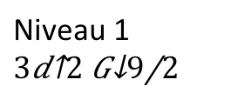
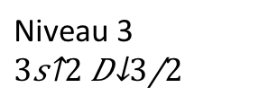

Principle of Laser Induced Fluorescence
Measurement based on :
  Excitation and emission of photons by an atom or an ion. In our case, Ar⁺ ion.
  Doppler effect.
ASTRO
Opération XPM
Niveau 2,
Level 1 to level 2 transition condition:
Laser frequency = transition 1-2 frequency
LASER
611,492nm
Fluorescence
460,957nm
Emitted fluorescence proportional to the number of excited ions (atoms)
Niveau 1
Niveau 3

Slide 15
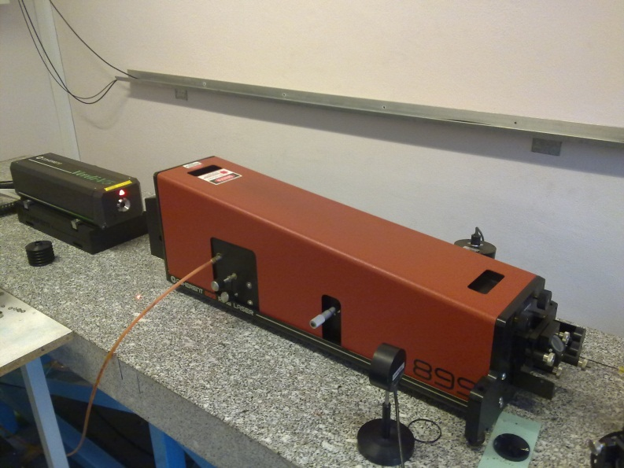
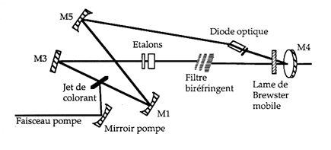
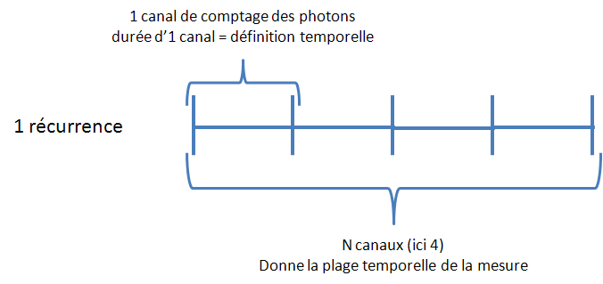
LIF instruments
Dye Laser
Multi-Channel Scaler (MCS)
ASTRO
The MCS allows to:
Count photons (detected by a photomultiplier).
Add temporal resolution to measurement.
Usual parameters:
Temporal definition between 5ns et 65535s
Between 4 et 16384 possible temporal channels.
Up to 4 billions repetitions of measurement possible (increase S/B).
Opération XPM
Power : 400mW at 611,5nm
Spectral width : 0,5MHz
Notes:
Transport « anormal » = non collisionnel
Propulseurs plasma à effet Hall : le transport anormal réduit le confinement des électrons → réduction de l’efficacité du propulseur

Slide 16
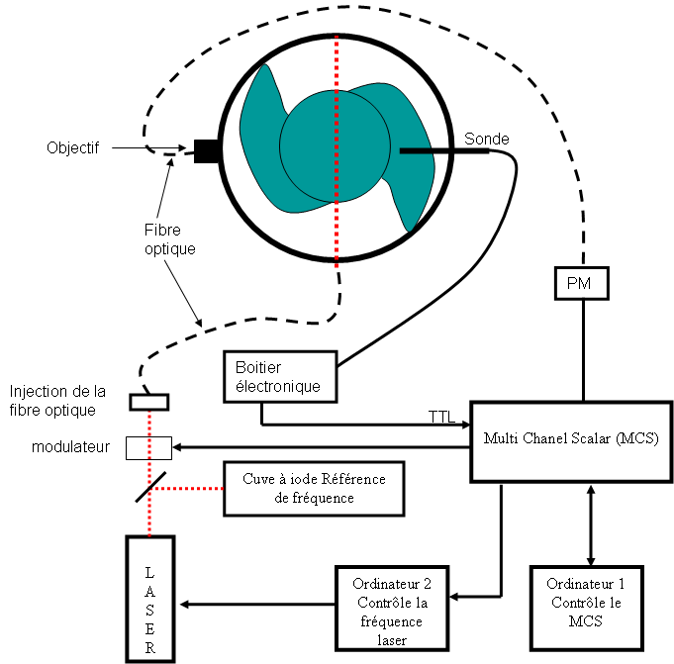
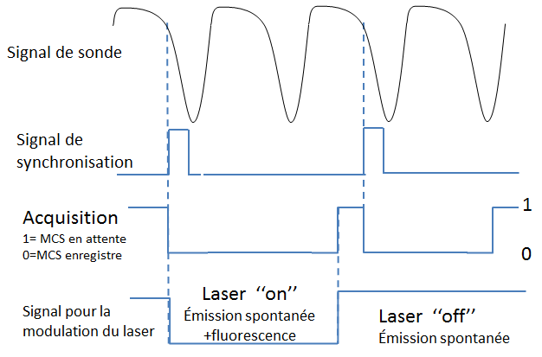
LIF on MISTRAL experiment
2 Measurements:
  laser on
  laser off
  Allows to substract background signal (spontaneous emission)
  Synchronization with perturbation to keep temporal definition during recurrences.
ASTRO
Opération XPM
Notes:
Transport « anormal » = non collisionnel
Propulseurs plasma à effet Hall : le transport anormal réduit le confinement des électrons → réduction de l’efficacité du propulseur

Slide 17
Axial velocity distribution function for m=2 mode
ASTRO
Opération XPM
No velocity variation. Density fluctuation (~10%) => No drift wave.
Notes:
Transport « anormal » = non collisionnel
Propulseurs plasma à effet Hall : le transport anormal réduit le confinement des électrons → réduction de l’efficacité du propulseur

Slide 18


Radial and azimuthal measurements
Velocity vector reconstruction in one point
Hypothesis: structure in uniform rotation
  1 = radial velocity
  2 = azimuthal velocity with π/2 phase
  with temporal synchronization of density for the 2 measurements
$$v_{radiale}$$
R=5cm, diaphragm
ASTRO
Probe
Opération XPM
1
$$v_{azimutale}$$
2
r=3cm
Notes:
Transport « anormal » = non collisionnel
Propulseurs plasma à effet Hall : le transport anormal réduit le confinement des électrons → réduction de l’efficacité du propulseur

Slide 19
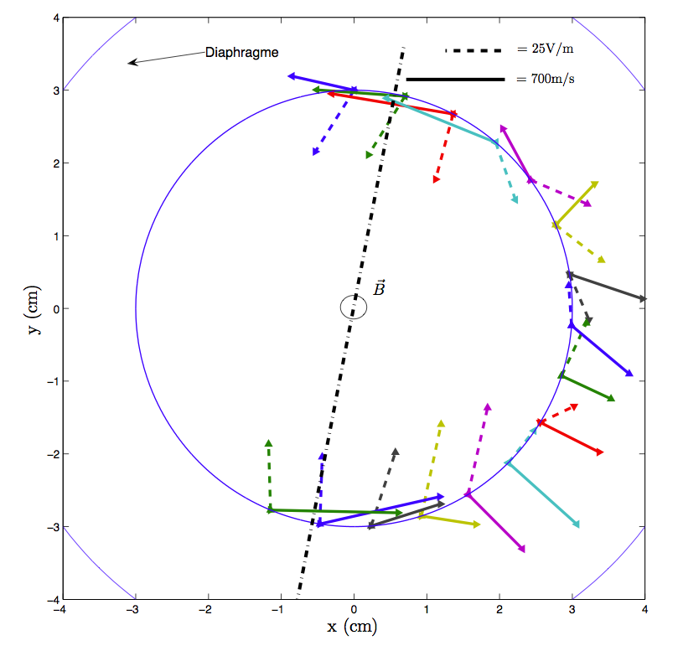
LIF measurements in Mistral
- : ion velocity (m/s)
-- : electric field (V/m)
-. : mode m=2 axis
No whole column ExB drift
No clear signature of instability
[Rebont PRL 2011]
Notes:
LIF mode m=2
La vitesse de rotation de la structure (1400m/s) est plus grande que la vitesse de rotation des ions lors de son passage (700m/s).
Vitesses azimutales des ions lors du passage des bras et des vitesses radiales d’ ́éjection en dehors.
Fréquence cyclotron ionique = 6kHz – fréq. Rotation = 7,5 kHz (mode m=2) ; 5 khz (mode m=1)

Slide 20
Tomographic study of magnetized plasma column instabilities (MISTRAL)
P. David PhD thesis
Advantages :
  2D spatial structure of regular modes
  without any hypothesis
  non intrusive
« Turbulent » modes study
Possible « one shot » acquisition
2x64 channels, ν_{acq} = 1 MHz
Notes:
Etude paramétrique très complète des modes réguliers dans MISTRAL
→ La tomographie permet la levé d’ambiguïté sur la structure spatiale des modes

Slide 21
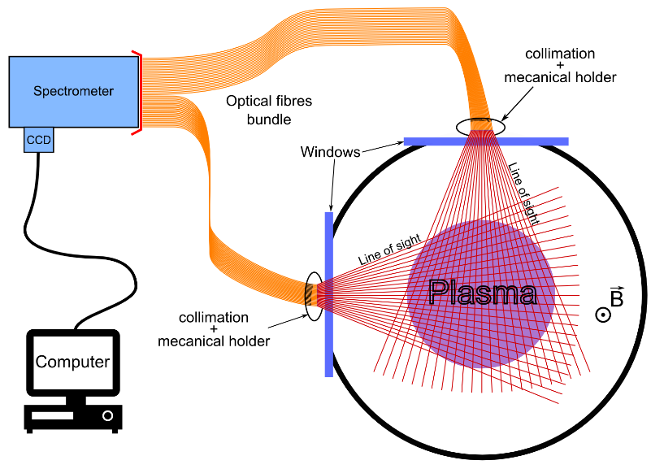
Tomography : experimental set-up
→ Instantaneous measurements, or on reproducible phenomenons : spatial structure study of regular modes.
Detector
Mechanical holder
Mechanical holder

Slide 22
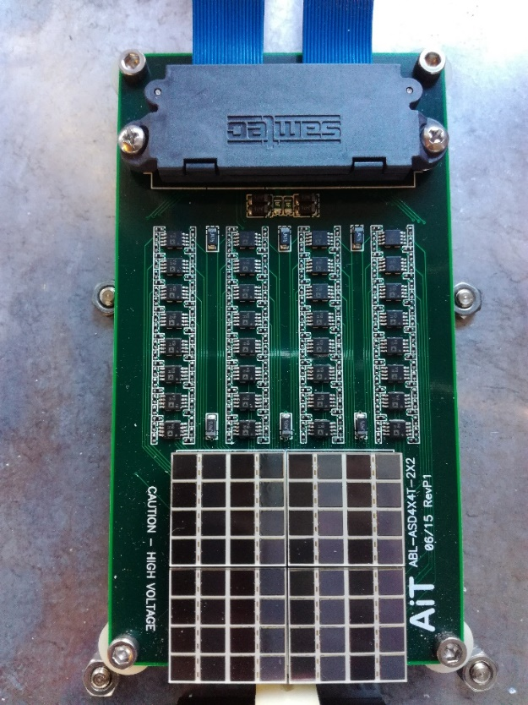
Experimental set-up: captors matrix
Captors :
2 x 64 bundle fibres Ø100 µm x 5 m
128 x SiPM detectors bar
  Gain (> 10⁶, PDE > 30%) with weak voltages/PMTs (∼ 20 to 40 V)
Fast response time : <100 ps
ν_{acq} max. = 1 MHz
Amplification
stage
Limitations :
No spectral resolution
Important noise: “fake“ signals
(after pulse/cross talk)
8x8 matrix detector
Toulouse 21-23 June 2017
Notes:
Silicon PhotoMultiplier (SiPM) is an innovative solid state silicon detector with single photon sensitivity. SiPMs are a valid alternative to photomultiplier tubes (PMT detectors)

Slide 23
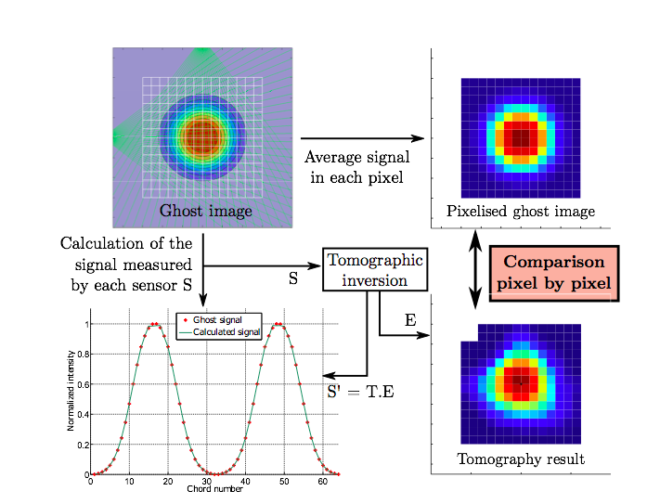
Tomography : validation of inversion code

Slide 24
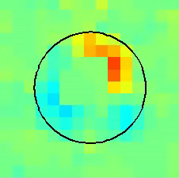
First tomographic results …
Local emissivity of an m=1 flute mode
Spatial structures of regular modes
Weak perturbation by probe
Radial profile more peaked: primary electrons
V_{p} and n_{e} : π/2 phase delay
40
Y axis (mm)
0
-40
-40
0
40
X axis (mm)
[P. David POP 2016 ]
Notes:
Profil émission tomographie plus piqué que profil radial sonde → les é.p. plus au centre jouent un rôle important dans le rayonnement du plasma

Slide 25
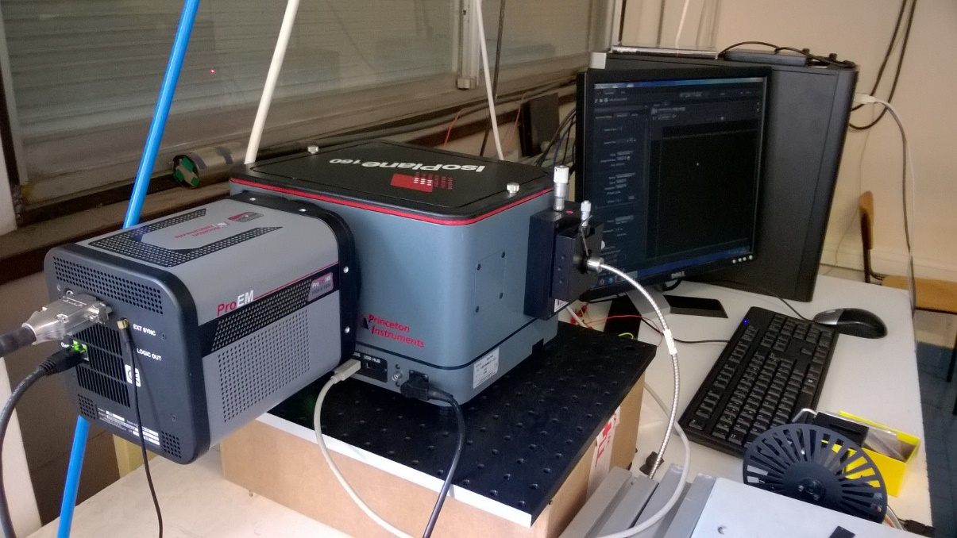
Spectro-tomography for instabilities study
Study of regular/turbulent structures ?
→ diagnostic (n_{e},T_{e}) Tokamak WEST
Mesurement of n_{metastable} in a cold plasma
Post-doc. R. Baude (AMIDEX DEMON)
Spectroscopy : spectral resolution
Tomography : spatial resolution
40 lines coupled with CCD / camera
[R. Baude in preparation for RSI]
Toulouse 21-23 June 2017
Notes:
Diagnostic plasma de bord WEST
Anomalies spectres plasma He

Slide 26
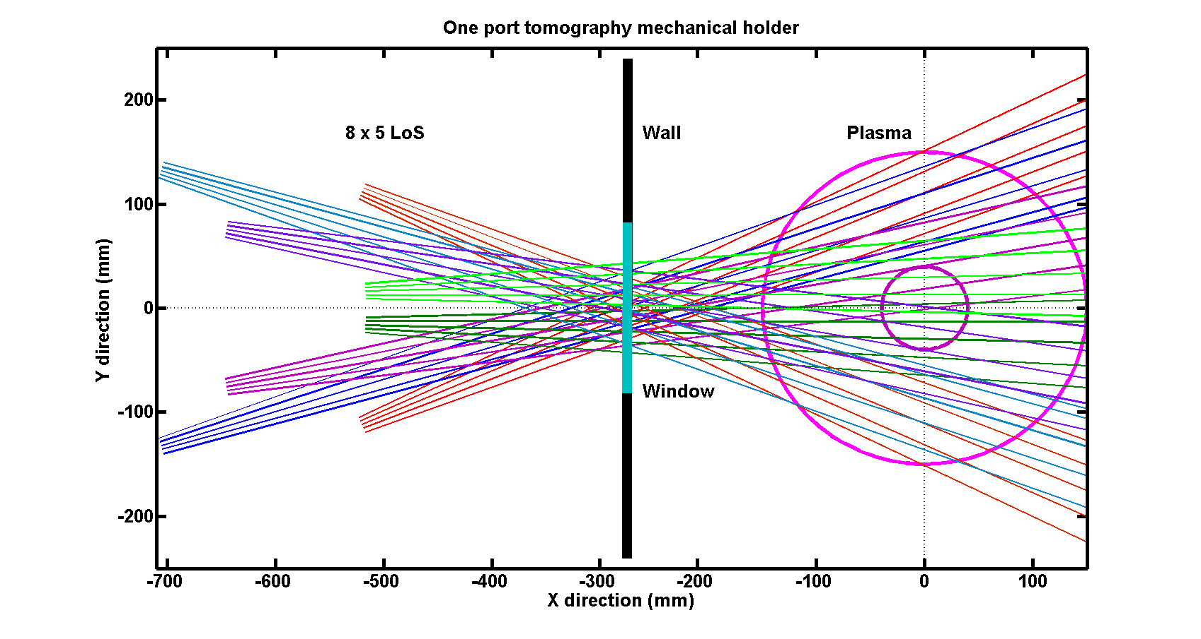
Spectro-tomography
Study of a bunch of lines of sight via a single optical access
Opto-mecanical supports
LoS
Windows
Plasma column
∼ 400 mm
Toulouse 21-23 June 2017
Notes:
Diagnostic plasma de bord WEST
Anomalies spectres plasma He

Slide 27
Development of a diagnostic to measure directly
electric field : EFILE
ASTRO
Electric field → Emission Lyman-α of a probe H (2s) beam
Measurement of static and/or fluctuating electric fields (vacuum or cold plasma, density 10¹¹ cm⁻³, sheaths) → OK
Project/Challenge :
Measurement of local electric field in Mistral
Measurement of electric field in front of ICRF IShTAR (Ion cyclotron Sheath Test Arrangement) antenna
Opération XPM
[Cherigier-Kovacic RSI 2015 ; Doveil PPCF 2016]
Notes:
IShTAR : Ondes ICRF → érosion

Slide 28
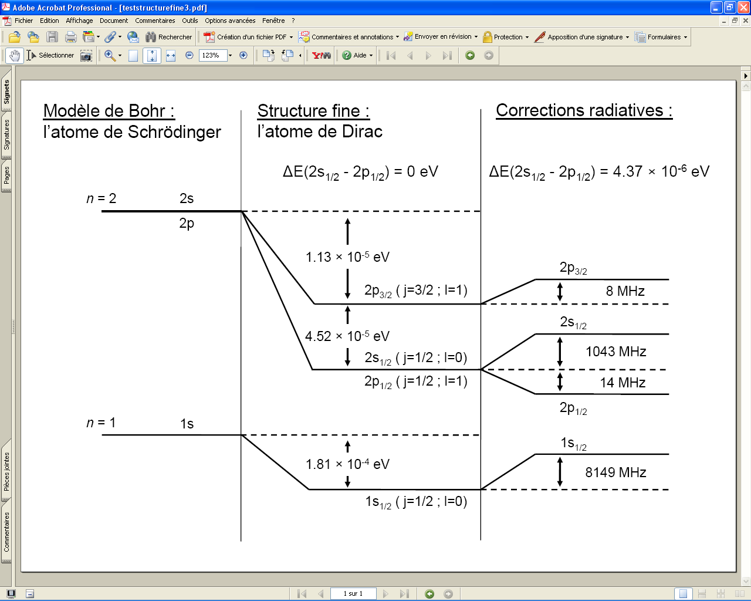
  Lamb shift
• Second property of hydrogenoids :
Lamb-shift due to radiative corrections
Schrödinger’s equation :
Dirac’s equation : fine structure
Radiative corrections :
ν₀

Slide 29
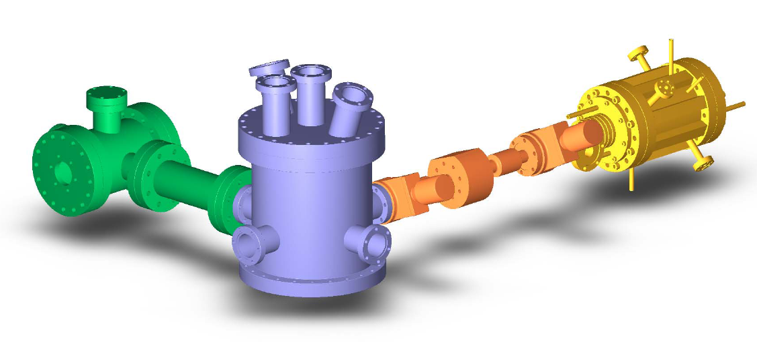
  Schematic view of the EFILE experiment
Plasma source : multipolar device
+
Einzel lenses (extraction)
Collection of Lyman α emission
Caesium vapor oven (neutralization)
Test chamber: interaction
probe beam – electric field + diagnostics* beam / plasma
* mass spectrometer, energy analyzer, Langmuir probes

Slide 30
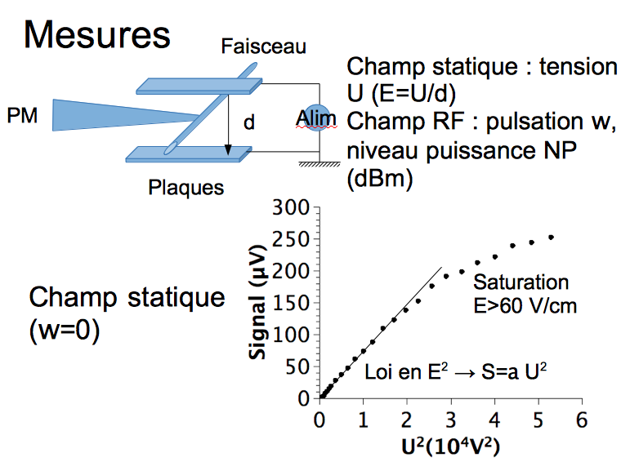
E measurement in the shadow of a limiter : principle
ASTRO

Slide 31
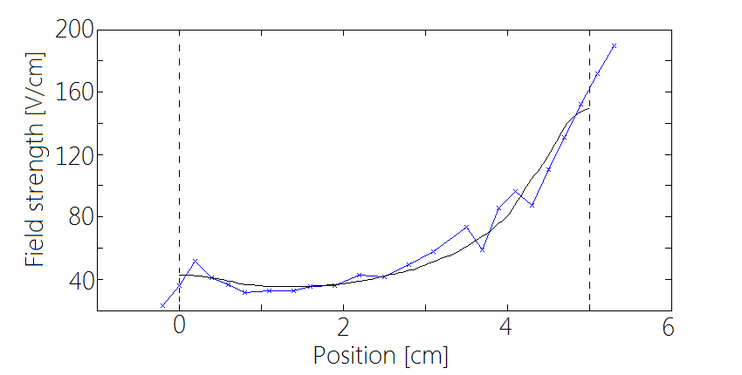
EFILE : results
ASTRO
Diagnostic EFILE in vacuum: comparison with numerical simulation FEM
Opération XPM
Diagnostic EFILE in plasma
Formation of a plasma sheath:
Electric field profile measured -in vacuum (white triangle)
-in test plasma (black triangle)

Slide 32
Conclusion : MISTRAL experiment
Non-intrusive optical diagnostics:
  LIF measurements
  Tomography/instabilities
  Radiative transfer
  Spectro-tomography ( complex plasmas)
Collaboration with Tokamak WEST :
  AMIDEX DEMON
  Diagnostic (n_{e}, T_{e}) WEST : neutral beam injector test in MISTRAL
  Spectro-tomography
  Neutral beam injector project (TP/CIML/IRFM) → Hélicon
  External collaborations :
  Simulations with code MCC-PIC LAPLACE Toulouse (JP Bœuf)
  Atomic physics : code SOPHIA LULI (F.B. Rosmej)
  New LIA DSC - MHD instabilities PANTA (Japan)
ASTRO
Opération XPM
Notes:
PANTA : Plasma Assembly for Nonlinear Turbulence Analysis

Slide 33
Annexes
ASTRO
Opération XPM

Slide 34
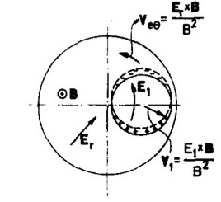
Simon-Hoh instability (Phys. Fluids 1963)
ExB drift:
Électrons : v_{eθ}
Friction forces (e-neutrals)
Ions slowed down:
v_{iθ} < v_{eθ}
Charge separation: E₁
Instability
- Not coherent with LIF
- Universality problem
ASTRO
Opération XPM
[Hoh; Simon Phys. Fluids 1963 ; Jaeger PhD 2009 ; Pierre POP 2016]
Notes:
Instabilité de SIMON-HOH : profil radial de vitesse inverse au profil de densité

Slide 35
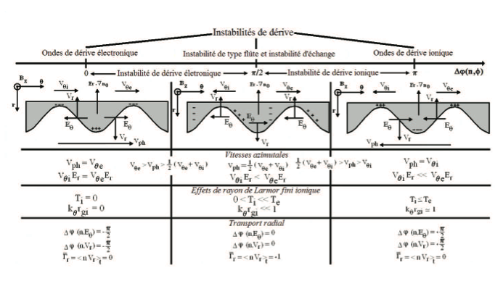

Slide 36
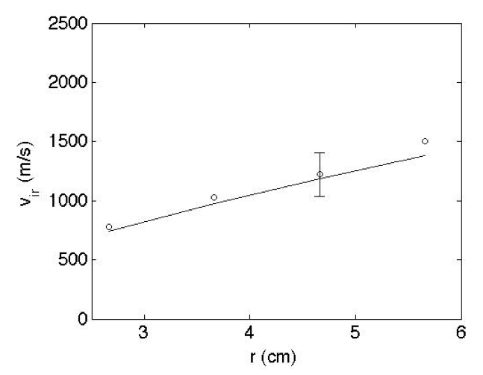
Radial ions velocity by LIF
→
[C. Rebont, thèse 2010]

Slide 37
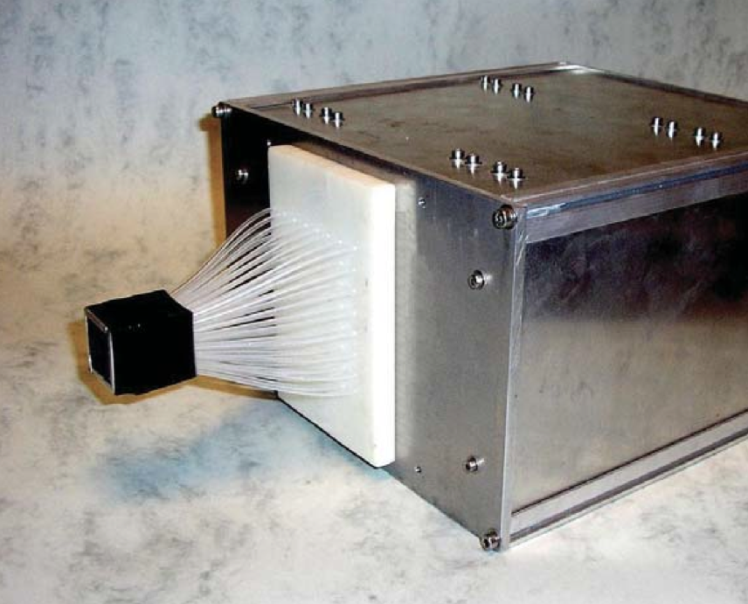
Mistral diagnostics : Cameras
Ultra-fast camera
max. acq. frequency : 200 kHz
Spatial resolution : 8x8 pixels
Stanford Computer Optics intensified camera
max. acq. frequency: 25 Hz
spatial resolution : 736x572 pixels
min. exposure time : 1 ns
Ultra-fast camera
developped in the lab.

Slide 38
Relation between plasma radiation and parameters ?
Weak density : coronal model
2 electrons populations : f_{e} = (1 – p_{hot}) f_{cold}(T_{cold}) + p_{hot}×f_{hot}(T_{hot}, E_{hot})
→ Eq. population for an excited state :
→ Eq. population for a metastable state:
Notes:
Modèle coronal :
issus des étude de la couronne solaire
Opposé extrême du modèle ETL pour les plasmas de très hautes densités
- Probablement pas valable dans MISTRAL pour l’équilibre d’ionisation
2 sets de section efficaces d’excitation par collisions électronique (Bartschat et Yanguas) : résultats similaires

Slide 39
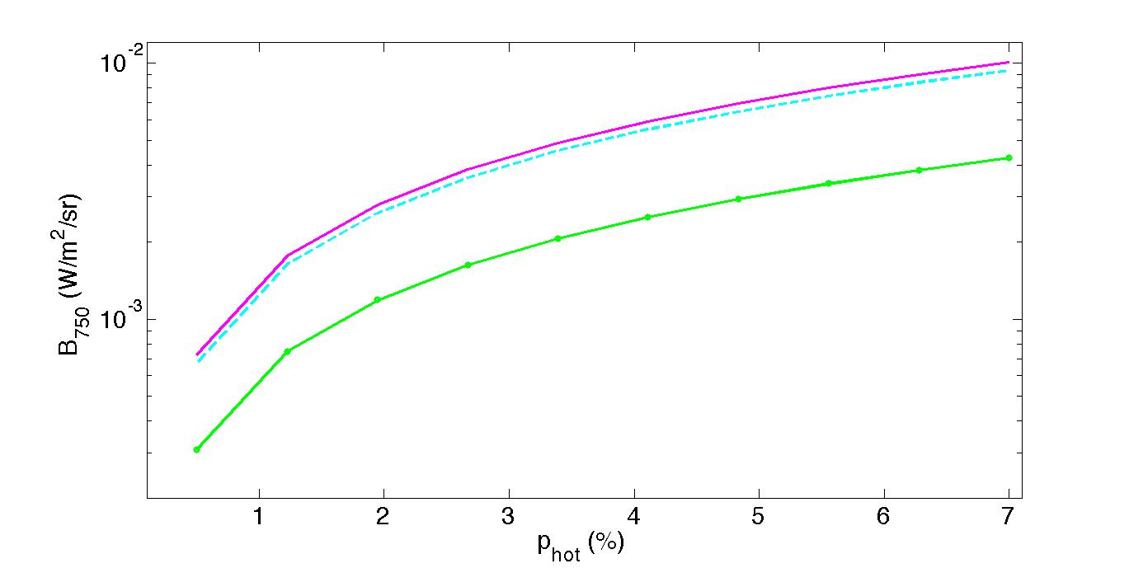
Coronal model for Argon
Experimental :
n_{e}(r = 7,5 cm) = 7,2 x 10⁸ cm⁻³
T_{e}(r = 7,5 cm) = 2,1 eV
= 3,3 ✕ 10⁻³ W.m⁻².sr⁻¹ (-)
Coronal model : B₇₅₀
E_{hot} = 40 eV ; T_{hot} = 10 eV ( )
E_{hot} = 40 eV ; T_{hot} = 20 eV (--)
E_{hot} = 10 eV ; T_{hot} = 20 eV (o)
→ Présence of primary electrons in the shadow of diafragm
→ Consistent with energy analyzer maesurements [Jaeger POP 2009]
[Escarguel EPJD 2012]
Notes:
Collecteur polarisé au potentiel flottant ou négativement : le surplus de charges issues de la chambre source est évacué radialement.

Slide 40
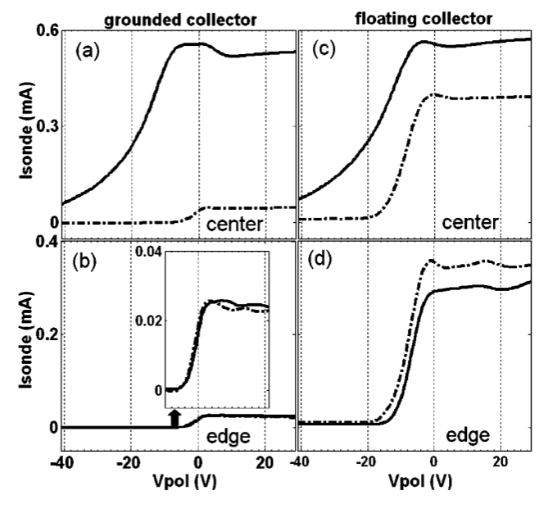
Measurement with energy analyzer
Notes:
Modèle coronal :
issus des étude de la couronne solaire
Opposé extrême du modèle ETL pour les plasmas de très hautes densités
- Probablement pas valable dans MISTRAL pour l’équilibre d’ionisation
2 sets de section efficaces d’excitation par collisions électronique (Bartschat et Yanguas) : résultats similaires

Slide 41
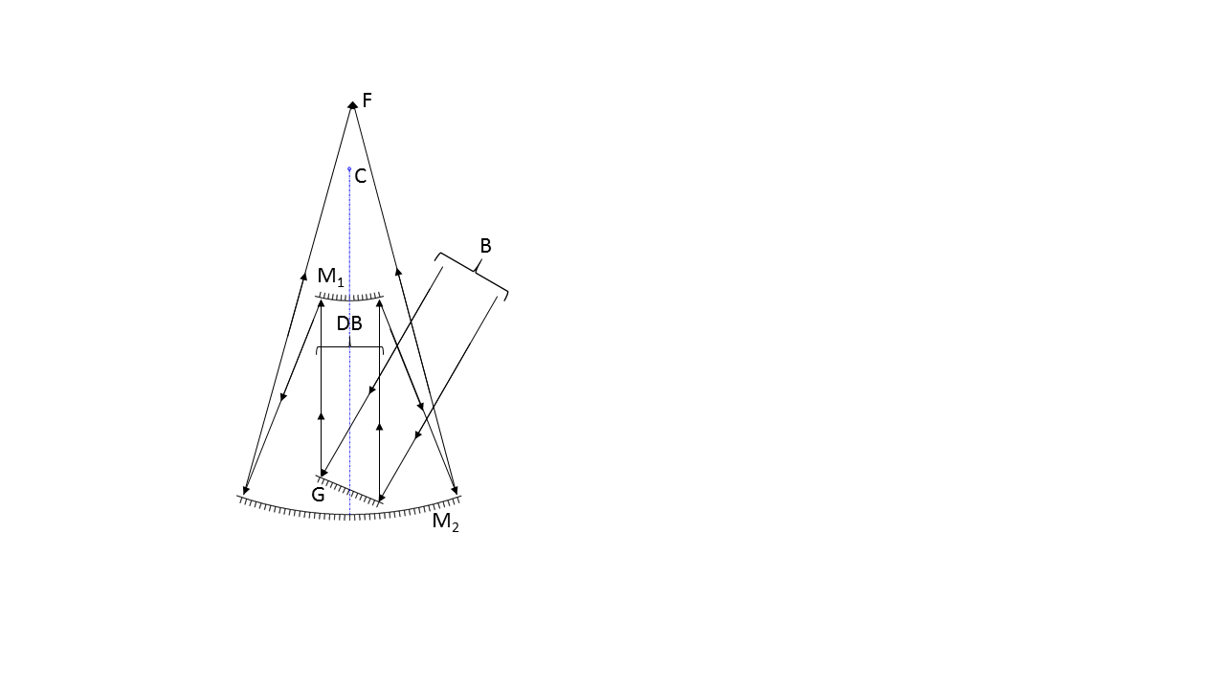
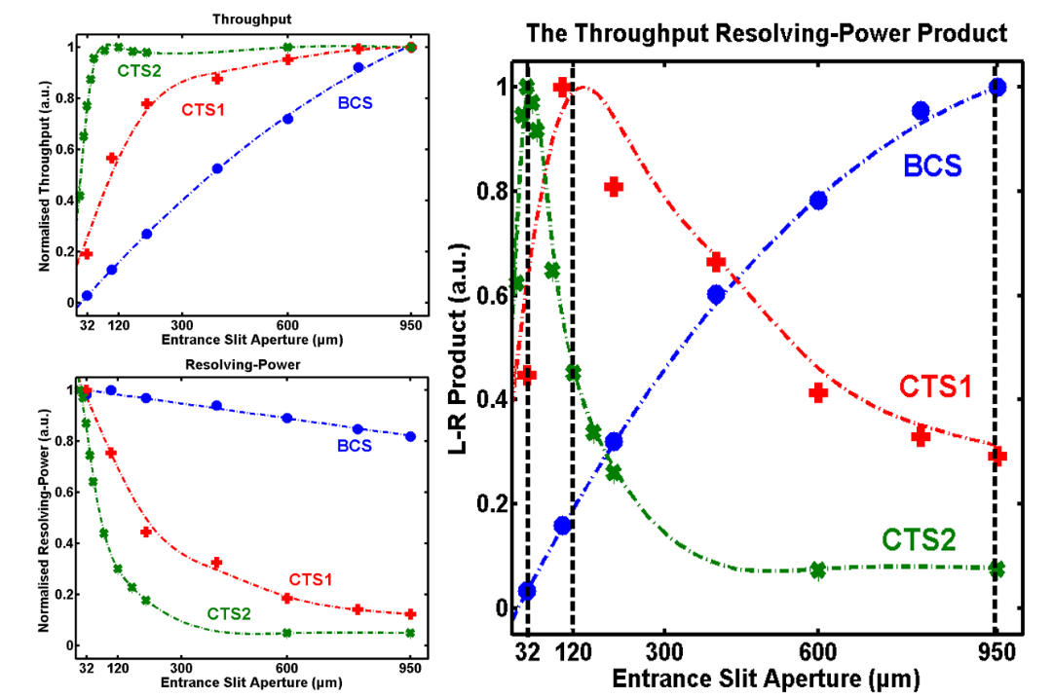
Large aperture imaging spectrometer
Comparison of the L*Rp product between Czerny Turner and Bowen Chamber spectrometer
B : incoming beam
G : grating
DB : diffracted beam
M₁ : primary convex mirror
M₂ : secondary concave mirror
C : mirrors curvature centre
F : chamber image focal field
BCS = Bowen Chamber Spectrometer
CTS = Czerny Turner Spectrometer

Slide 42
Rotation frequency of m=1 mode vs. experiment parameters
→ions and electrons momentum conservation (F. Chen 1984) :
Convective term
Fields
Frictions
[Annaratone et al. POP 2011]

Slide 43
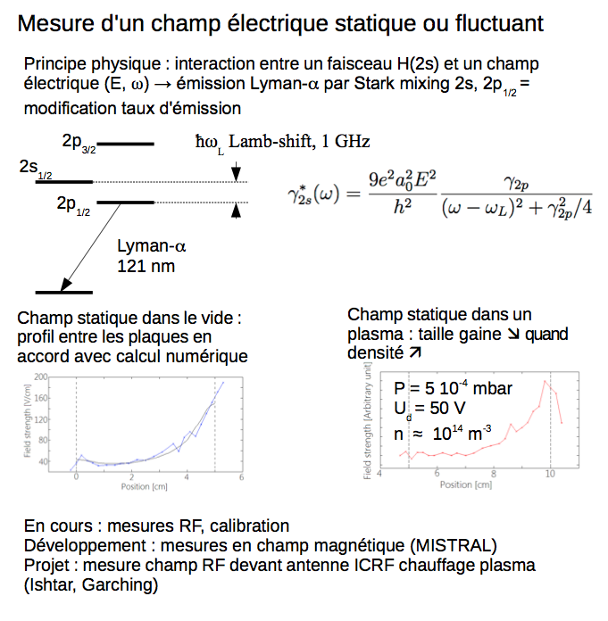

Slide 44
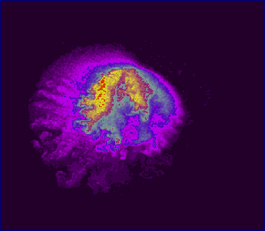
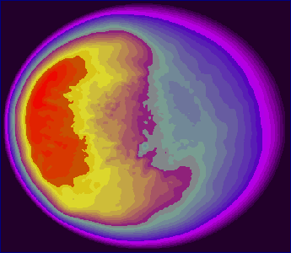

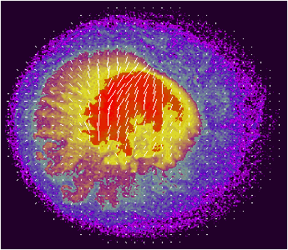
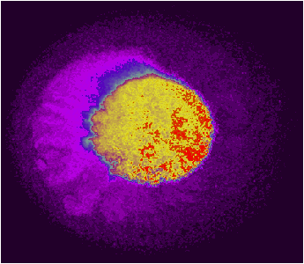
Negative Ion Source for Neutral Beam Injection
Plasma rotation in an e-beam sustained magnetized plasma column
n (10¹⁴ m⁻³)
φ (2.5 V)
t =
μs
1
n (log, 10¹⁴ m⁻³)
T_{e} (5 eV)
0

Slide 45
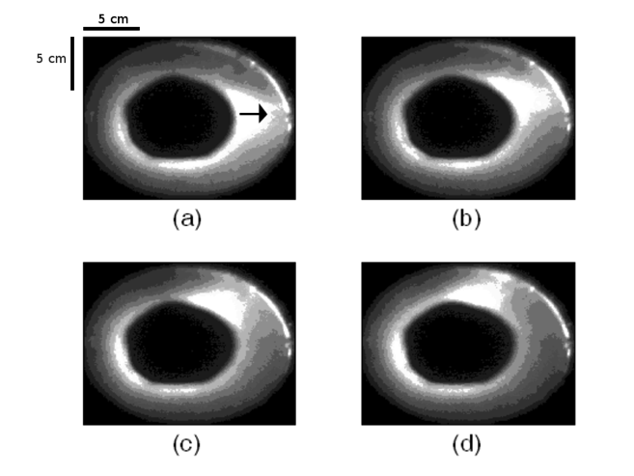
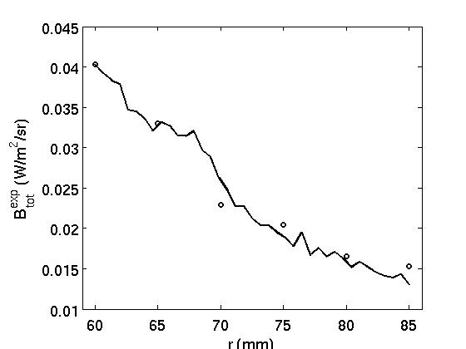
Low frequency instabilities : emission spectroscopy
I (nomr.)
O : brillance exp. ArI(750,4nm)
- : caméra (normalisé)
Mode m=1 - Δt = 5 μs – image every 10 μs
→ ArI(750,4 nm) line gives global plasma emission behaviour.

Slide 46
New configuration
Installation of 2 half-cylinders to measure radial current: each half-cylinder can be biased separately.
Half-cylinder
Notes:
46

Slide 47
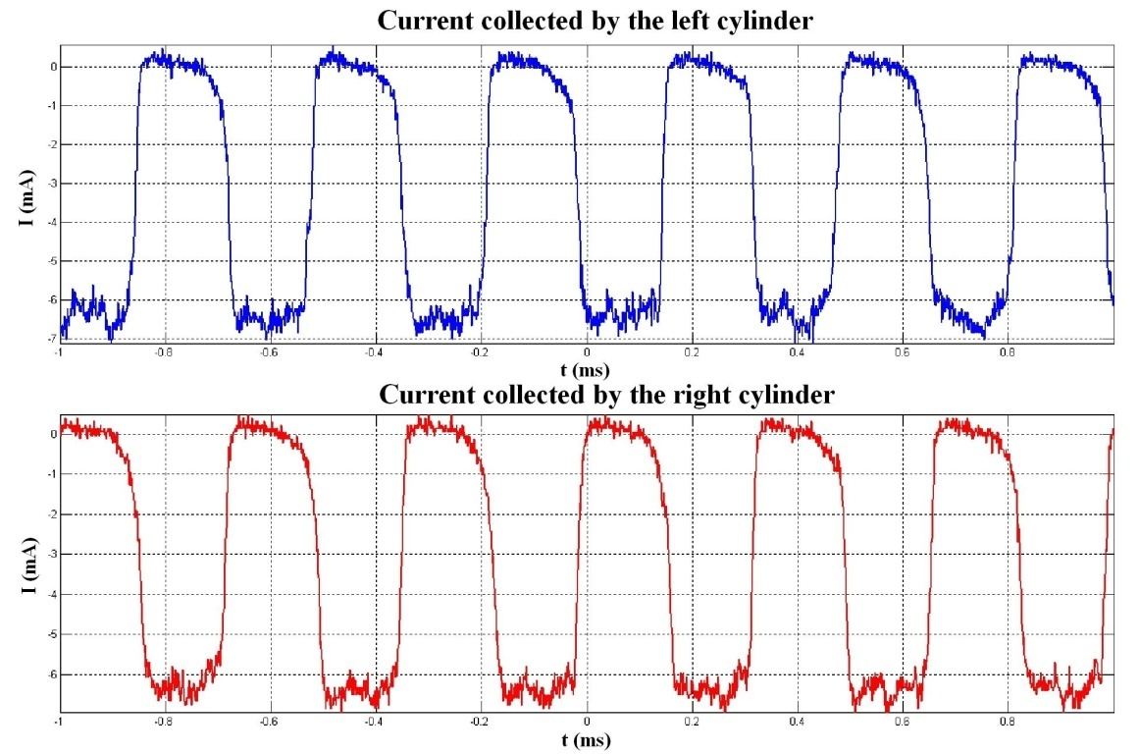
Results
S.Jaeger, et al. (2009)
rotation of 1 arm (mode =1) observed on cylinders
influence of end conditions:
1) grounded collector
=> injected // current = collected current, no radial current
2) floating collector
=> injected // current > collected current => radial current toward cylinders
Increase of cylinder bias → « arm » rotation frequency increase via electric field increase .
Notes:
47

Slide 48
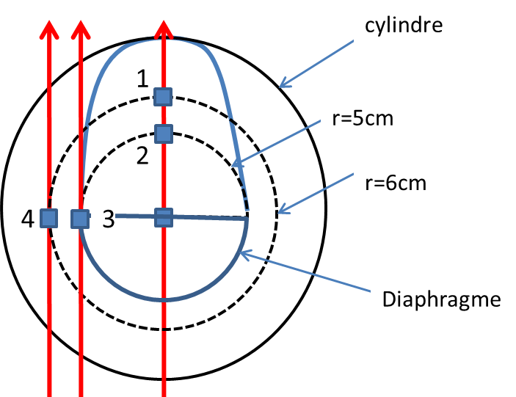
LIF measurements
Measurement between
r = 0 and 6 cm
ΔX = 1 cm
Mode frequency: 5 KHz < f_{ci}
LIF Δt : 100 μs
150 000 repetitions
Total acquisition time: 2 h for a time-resolved velocity distribution function
Experimental conditions:
  Grounded half-cylinders
  Floating separatrix and collector (-30 V)
  P = 9 10⁻⁴ mbar
  B = 16 mT

Slide 49
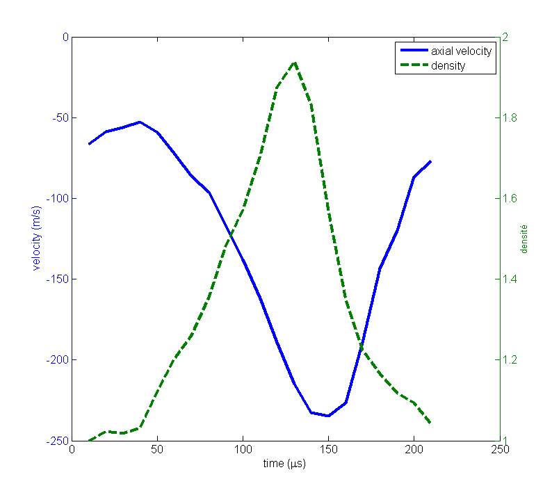
Axial distribution function
Modulation of mean axial velocity at the same frequency as perturbation
➔ possible drift waves

Slide 50
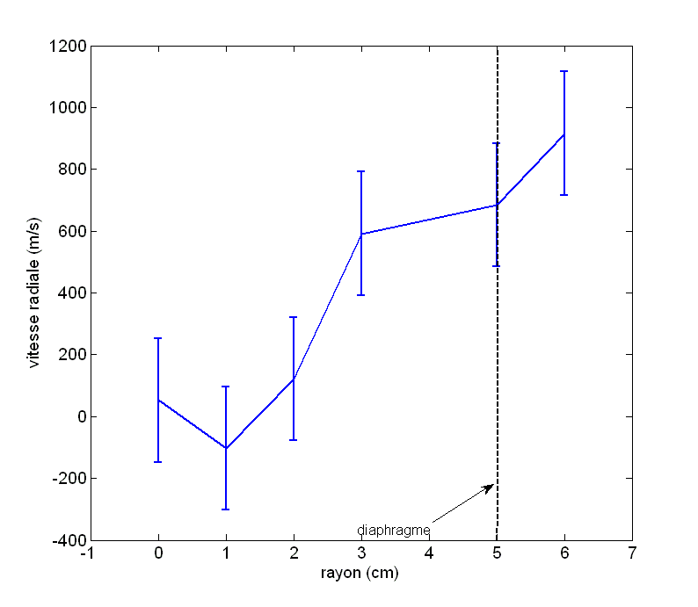



Radial evolution of velocity
azimuthal
Mean velocity at density maximum
radial
In the ionization zone, almost null velocity at any radius.
No « block » rotation.
Linear evolution of radial velocity
Density/velocity phase
Constant phase close to π/4
Phase: π/2 at center,
0 outside ionization zone

Slide 51




Results at r=5cm, ionization zone limit
azimuthal
At max and min density ivdf centered at zero velocity.
Flux: $Γ=n.V$
radial
Radial velocity always present.
Non-zero mean radial flux -> no drift wave

Slide 52


Results at r=5cm
Azimuthal electric field shows:
-max on rising density front
-differences according to used method (change of sign for energy conservation method)
Radial electric field extrema on density fronts ➔ changes sign.

Slide 53
Conclusion
Axial density modulation measured by LIF
No plasma rigid rotation
No simple ExB drift
No clear instability identification
Study influence of f_{ci}
B.M. Annaratone et al., Phys. Plasmas (2011)

