Slide 1
Fluid simulation of instabilities in partially magnetized plasmas
Gerjan Hagelaar
Laboratoire Plasma et Conversion d’Énergie (LAPLACE)
CNRS & Université Paul Sabatier
Toulouse, France

Slide 2
Introduction
Fluid simulations are widely used in low-temperature plasma research to obtain a qualitative picture of plasma device operation & predict trends
However: not accurate and sometimes qualitatively incorrect
Difficult case: (partially) magnetized low-temperature plasmas (Hall thrusters, Penning discharges, magnetrons, ...) because of plasma instabilities
  very sensitive to fluid approximations
  hard to solve numerically
  large influence on plasma device
Example: anomalous transport in Hall thrusters

Slide 3
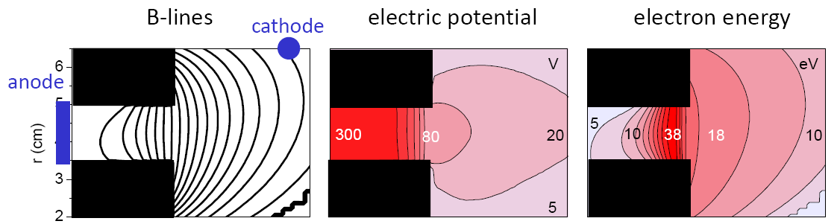
Electron transport in Hall thruster
0 V
300 V
electrons
B
Along B: large mobility → Boltzmann equilibrium:
Across B: transport by small perpendicular mobility →
Field lines are equipotential + diffusion term
Electric potential drop in magnetic field barrier to satisfy current continuity:
Conductance × Voltage = Current (Ohm's law)
G. J. M. Hagelaar et al, J. Appl. Phys. 91, 5592-5598 (2002)

Slide 4
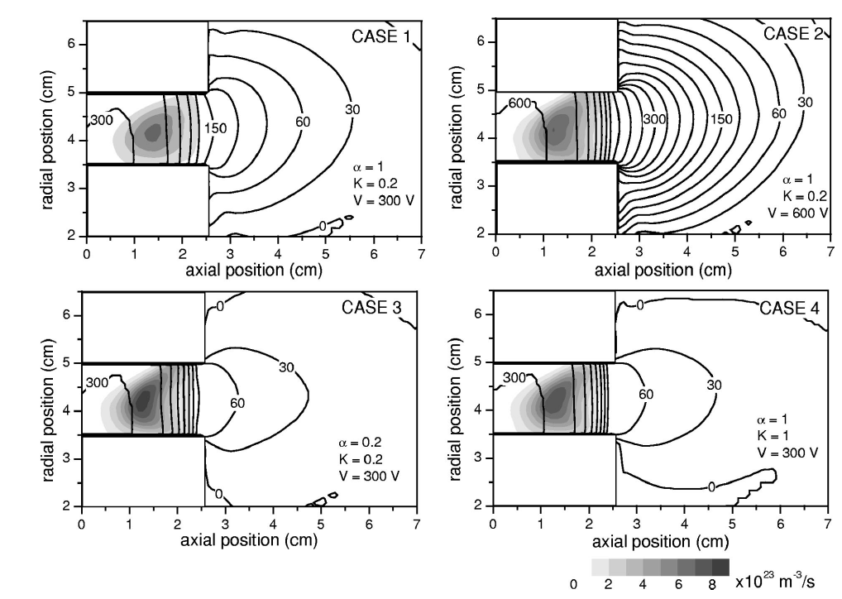
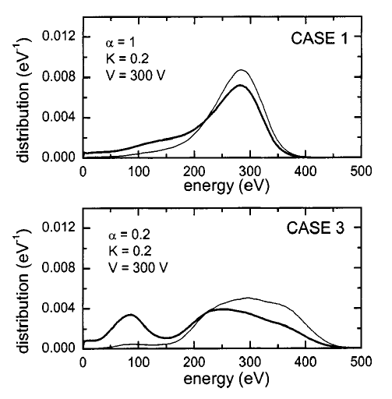
Problem: anomalous mobility
Measured perpendicular mobility >> classical expression
Add anomalous mobility with fit parameters:
Due to wall collisions and turbulence
Potential + ionization rate
Ion energy distributions
α = 1
K = 0.2
α = 0.2
K = 0.2
J. Bareilles et al, Phys. Plasmas 11, 3035-3046 (2004)

Slide 5
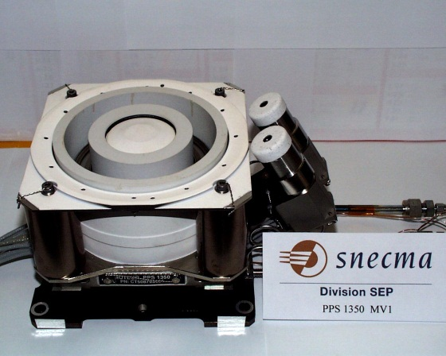
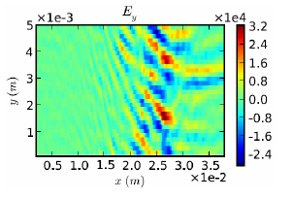
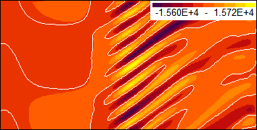
Anomalous transport due to E×B drift instabilities
Closed E×B drift in azimuthal direction tends to become unstable and then “leak” across magnetic field barrier
Requires simulation in plane (z,θ) ⊥ B field
PIC simulations: electron-cyclotron drift instability
Also fluid simulations predict drift instabilities & anomalous transport, but with different (unphysical?) behavior – how to handle this?
Azimuthal E-field
azimuthal
E×B drift
B
axial
applied E
Fluid simulations (later this talk)
PIC simulations (Adam)
J.C. Adam et al, Plasma Phys. Control. Fusion 50, 124041 (2008)

Slide 6
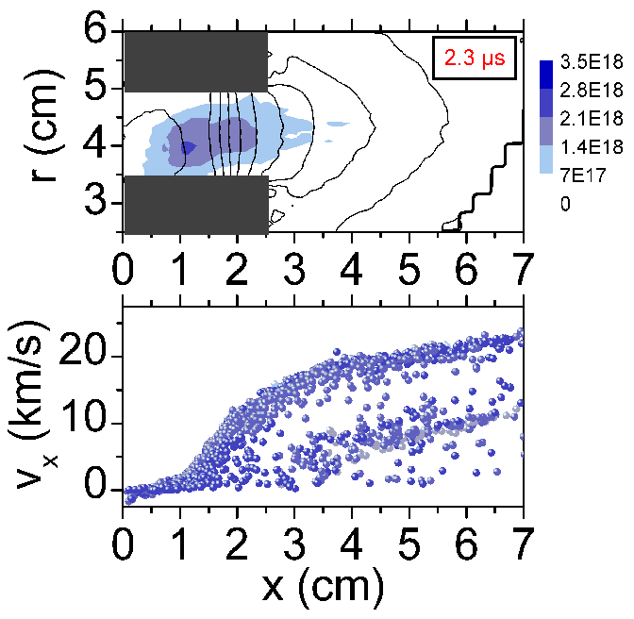
Transit-time instability in hybrid Hall thruster simulation
potential
+ plasma density
applied voltage
(exceeded by some ion energies)
ions in phase space
J. Bareilles et al, Phys. Plasmas 11, 3035-3046 (2004)

Slide 7
Contents of this talk
Purpose: demonstrate that fluid simulations of partially magnetized plasma devices in general involve plasma instabilities (in particular when describing plane ⊥B) – and raise questions about how to handle this
Examples from fluid code MAGNIS:
  Magnetic filter in ITER NIS & PEGASES
  Plasma column in CYBELE source
  Hall thruster
Questions:
  Physical relevance, validity, consistency with experiments and PIC simulations?
  Numerical constraints, convergence?

Slide 8
MAGNIS fluid model @ LAPLACE Toulouse
Multi-fluid: electrons, ions, neutrals
Continuity equations with chemistry source terms
Full momentum equations including inertia terms
Electron energy equation with magnetized heat flux
Quasi-neutrality: plasma potential deduced from current continuity
Boundary conditions from sheath theory, allowing for different wall materials: grounded, biased, dielectric
Evolution in time and 2D plane perpendicular to magnetic field lines
Parallel losses (along field lines) included via effective source terms (2D+½D) allowing for dielectric, grounded, or biased walls
Magnetized fluxes handled through original numerical scheme using prediction/correction on shifted numerical grids

Slide 9
Main fluid model equations
Continuity & momentum equations for each species α:
ionization
losses along magnetic field lines included in source term

Slide 10
Main fluid model equations
Continuity & momentum equations for each species α:
inertia
magnetic force
electric force
pressure force
collisions

Slide 11
Main fluid model equations
Continuity & momentum equations for each species α:
inertia
magnetic force
electric force
pressure force
collisions
Mobility tensor
“drift-diffusion” equation
electron flux =
parallel to B
very large, no confinement
perpendicular to B
very small
perpendicular to both B and forces
= magnetic drift
typically μ// : μ⊥ : μ× = 1000000 : 1 : 1000

Slide 12
Main fluid model equations
Continuity & momentum equations for each species α:

Slide 13
Main fluid model equations
Continuity & momentum equations for each species α:
Quasi-neutrality & current conservation:

Slide 14
Main fluid model equations
Continuity & momentum equations for each species α:
Quasi-neutrality & current conservation:
Electron energy:

Slide 15
Main fluid model equations
Continuity & momentum equations for each species α:
Quasi-neutrality & current conservation:
Electron energy:
Boundary conditions from sheath theory:

Slide 16
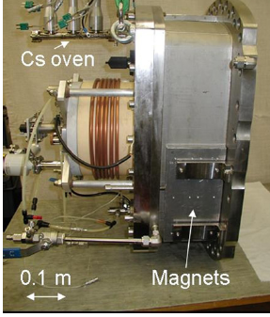
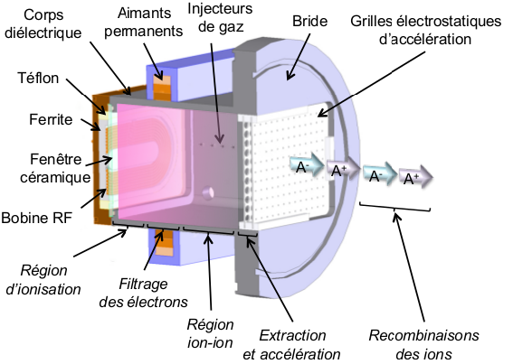
Magnetic filter sources
Some (negative) ion sources use a magnetic filter to separate a cold ion extraction region from a hot RF region
B
Ion extraction grids
RF heating
B
BATMAN prototype negative ion source for ITER NBI @ IPP Garching
Difference with E×B discharge devices:
Transport driven by pressure rather than applied voltage
Rectangular geometry!
E. Speth et al., Nucl. Fusion 46, S220 (2006)
A. Aanesland et al, PSST 23, 044003 (2014)
PEGASES thruster @ Ecole Polytechnique

Slide 17
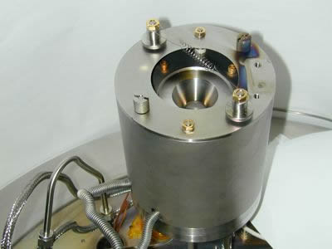
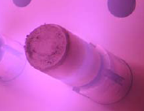
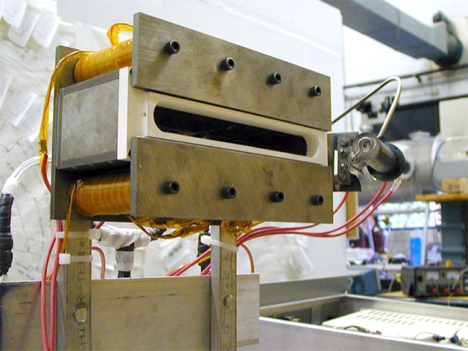
Closed drift versus bounded drift
Cylindrical symmetry:
magnetic drift forms closed loop → optimal ν/B² confinement
(if no instabilities)
No cylindrical symmetry:
drift bounded by walls →
Hall effect: plasma asymmetry & increased 1/B transport across magnetic field barrier
Side view:
driving force
B
physical wall
Top view:
Linear plasma thruster
@ University of Michigan
Did not work
Beal and Gallimore AIAA-2001-3649
B
driving force

Slide 18
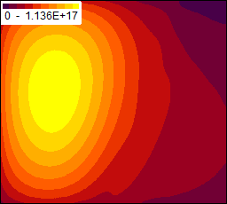
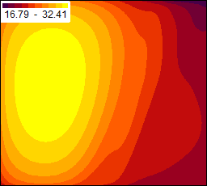
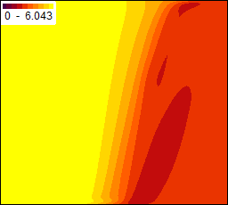
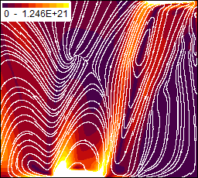
Hall effect in magnetic filter
Plasma density (m⁻³)
Potential(V)
Electron temperature (eV)
Electron flux (m⁻²s⁻¹)
B
15 V
12×12×12 cm³
1 mTorr Argon 100 W
0.01 T
hot due to RF heating
cold because no heating
Electron temperature drop across filter due to collisions + poor heat conduction
Hall effect: vertical asymmetry induced by magnetic drift → oblique 1/B electron flux across filter
B
RF heating
B

Slide 19
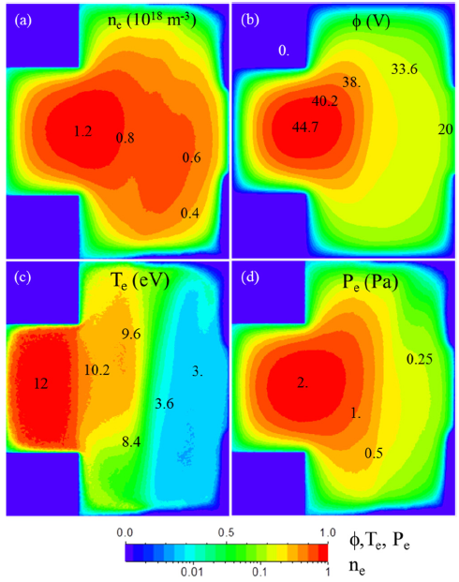
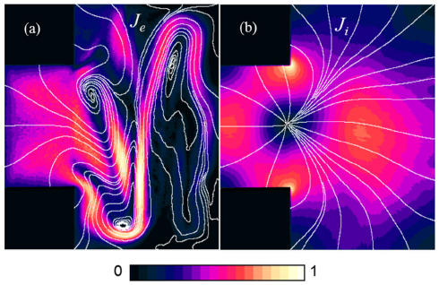
PIC simulations of prototype ITER negative ion source
Electron current density
Ion current density
B
Fully kinetic PIC simulations
J. P. Boeuf et al, Phys. Plasmas 19, 113510 (2012)

Slide 20
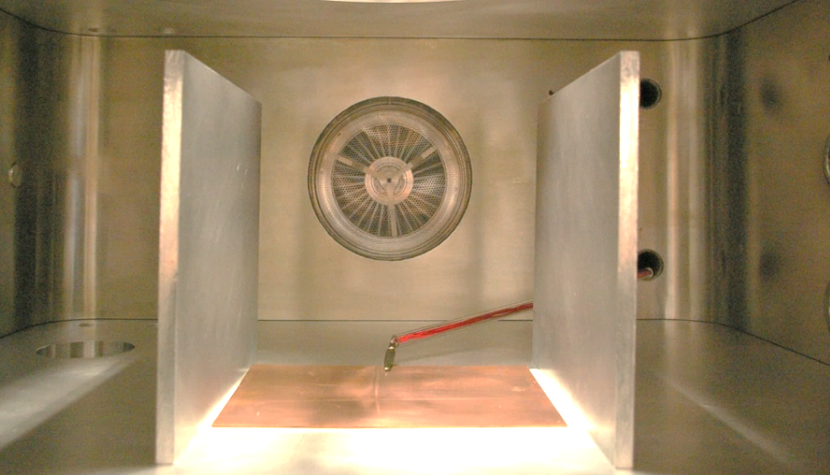
Experimental check of plasma Hall effect
Without applied voltage
Applied voltage 10 V
Strong asymmetry of extracted current density profile!
Argon, 0.7 Pa, 200 W, 1 mT
F. Gaboriau, R. Baude, and G. J. M. Hagelaar, Appl. Phys. Lett. 104, 214107 (2014)

Slide 21
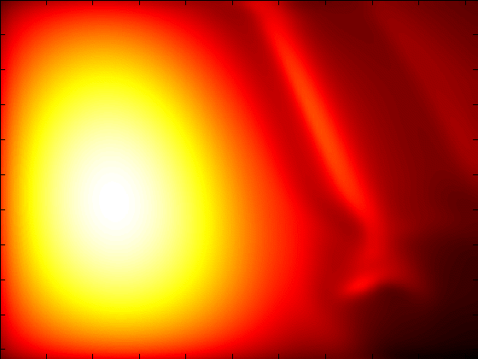
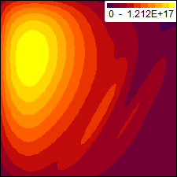
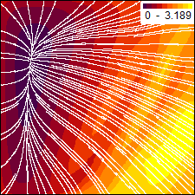
Fluid instabilities in magnetic filter
Longitudinal, ion acoustic or “transit time” like instability, related to ions becoming supersonic when crossing
T_{e} drop
Presence depends on applied V, B, parallel losses, ...
Not observed in PIC simulations or experiments
Almost no drift instabilities, drift stabilized by Hall effect
Plasma density
Instantaneous plasma density (m⁻³)
Ratio of ion mean velocity to local ion sound speed

Slide 22
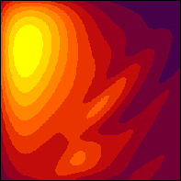
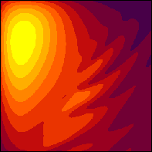
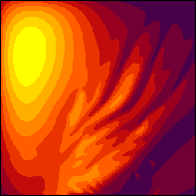
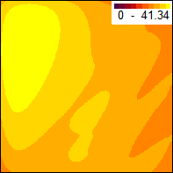
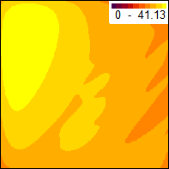
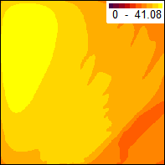
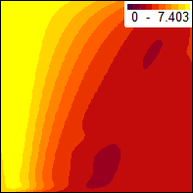
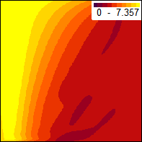
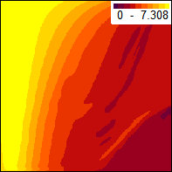
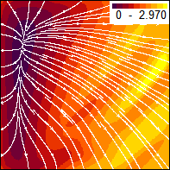
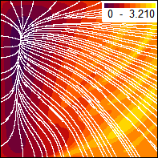
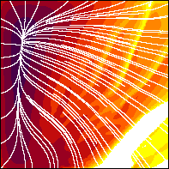
Mesh convergence
64×64
128×128
256×256
Plasma density
(m⁻³)
Electric potential
(V)
Electron temperature (eV)
Ion Mach number

Slide 23

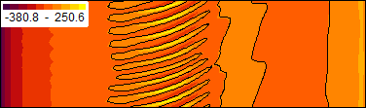

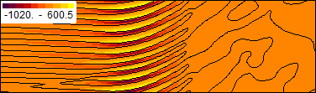
Drift instabilities in magnetic filter
Hall effect stabilizes magnetic drift in filter, no anomalous transport issue
Replacing walls by periodic BCs → no Hall effect → small-scale drift instabilities, observed in both PIC and fluid simulations
ω ≈ ω_{LH} ≈ 10⁷ rad/s
periodic boundary
Plasma density (m⁻³)
RF heating
B
Horizontal E-field (V/m)
periodic boundary
PIC simulations
Fluid model
(with inertia terms)
Vertical E-field (V/m)
3 cm
Phys. Plasmas 19, 113509 (2012)

Slide 24











Mesh convergence
64×128
128×256
256×512
Plasma density
(m⁻³)
Electric potential
(V)
Electron temperature (eV)
B field (T)

Slide 25
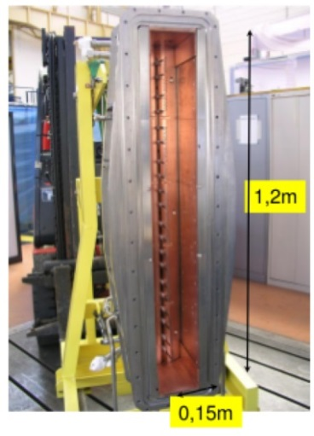
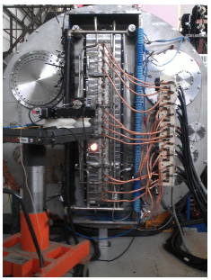
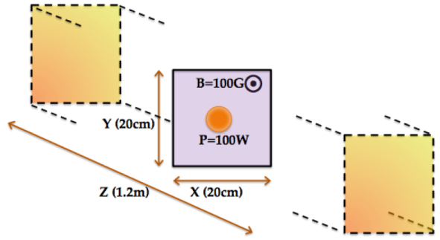
Magnetized plasma column
Classical problem: long (cylindrical) plasma column with axial magnetic field, relevant to some low temperature plasma devices (CYBELE, Mistral, Mirabelle, ... )
Boundary conditions at ends of column play important role
Plasma sustained by RF heating or filaments located near center
CYBELE negative ion source for NBI under development @ CEA Cadarache
∇(nT)×B
diamagnetic
drift
∇(nT) pressure gradient
1.7 mTorr hydrogen
B
A. Simonin et al, Nucl. Fusion 55, 123020 (2015)

Slide 26
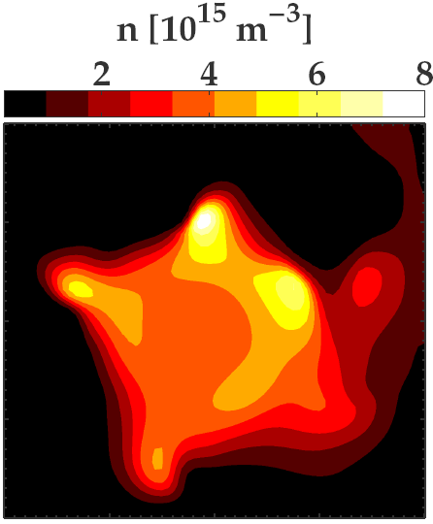
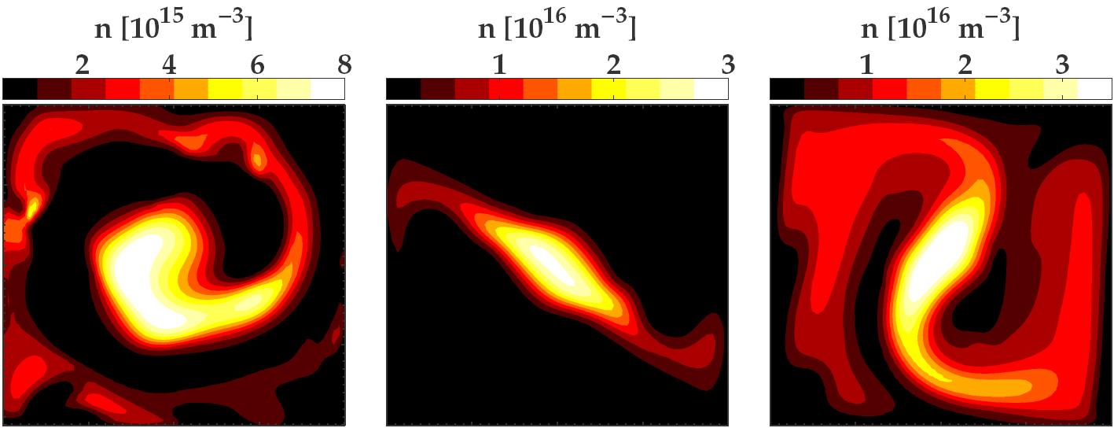
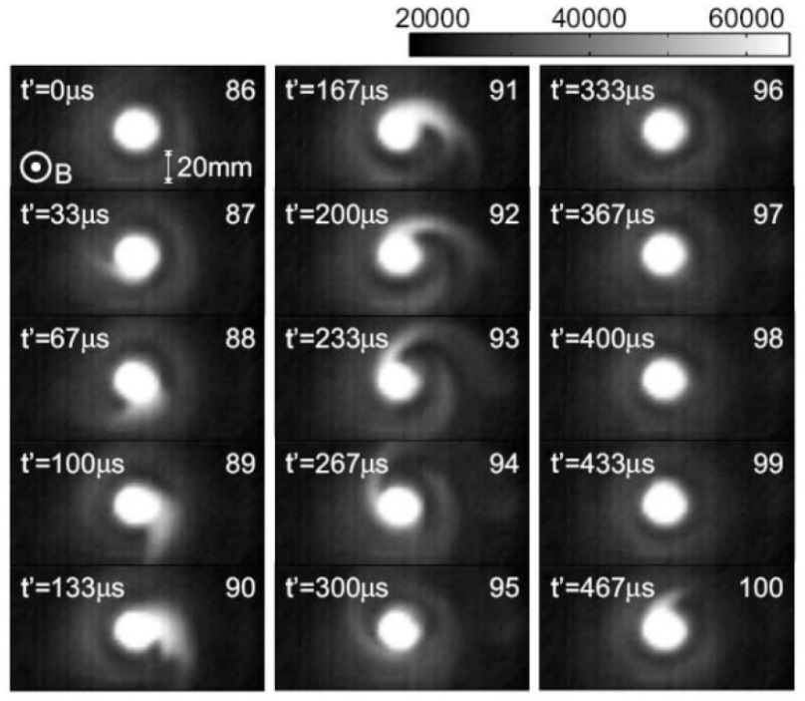
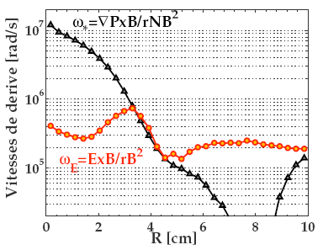
Rotating instability in plasma column
B = 3.5 mT
8 mT
13 mT
17 mT
Plasma tends to develop one or two "arms" rotating at 2-4×10⁵ rad/s, more or less as rigid objects
Successive CCD camera images taken in linear plasma device NAGDIS. From: H. Tanaka et al, Contrib. Plasma Phys. 52 (2012)

Slide 27
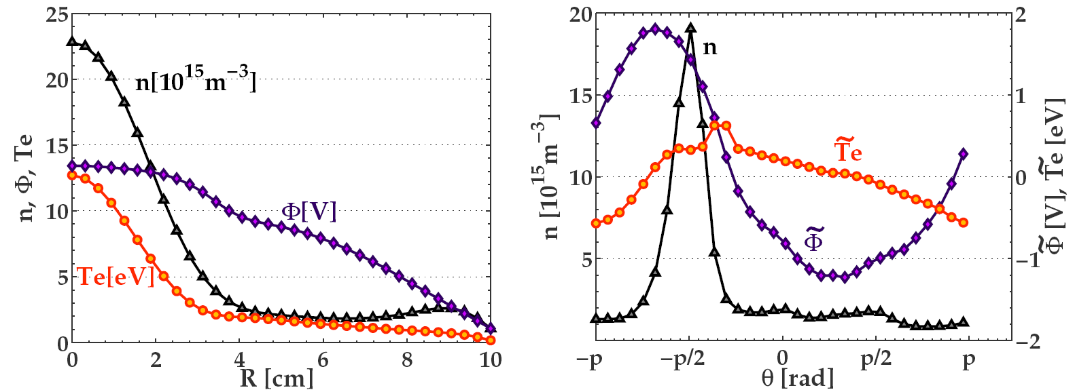
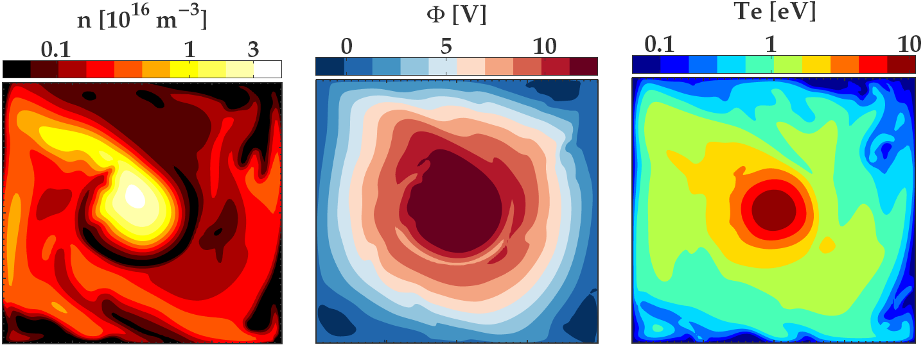
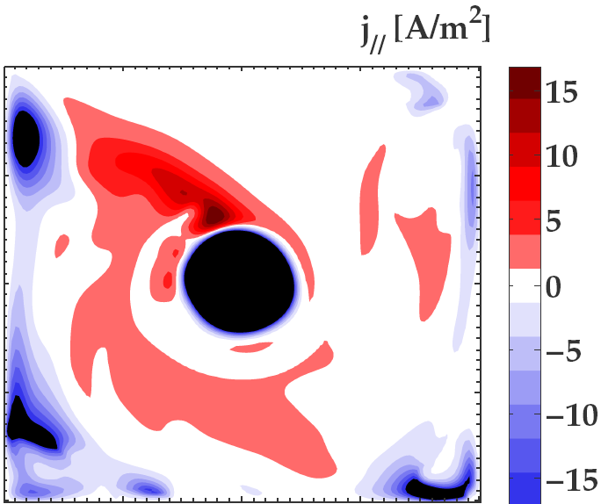
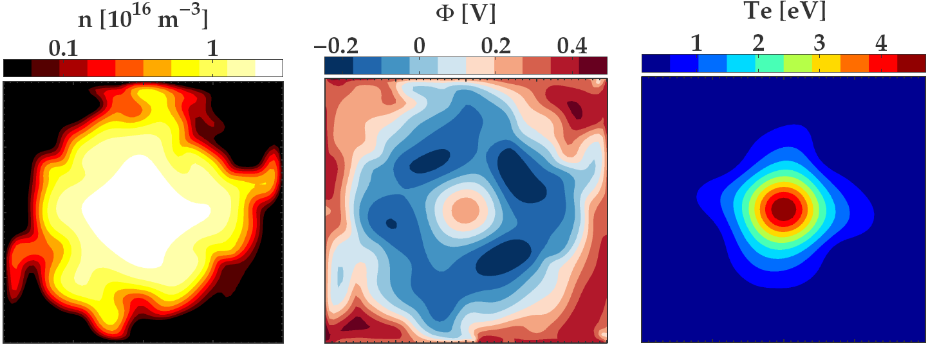
Plasma parameters in column
B = 10 mT
Azimuthal profiles in rotating frame
at 2.25×10⁵ rad/s
Time-averaged
radial profiles
e loss >> i loss
i loss > e loss
Conducting
walls at end of column
Dielectric walls
Current density toward walls at end of column
(Simon short-ciruit)

Slide 28
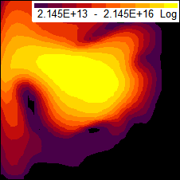
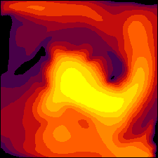
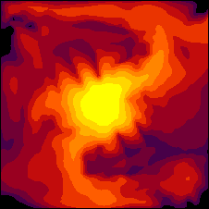









Mesh convergence
32×32
64×64
128×128
256×256
Plasma density
(m⁻³)
Electric potential
(V)
Electron temperature (eV)

Slide 29
E×B discharge in Hall thruster
Plasma sustainment depends directly on magnetized transport
Transport due to applied voltage rather than pressure gradient
Neutral gas depletion
Dielectric walls:
current-free plasma losses // B
Radial size 1.5 cm
Cathode:
injection // B of fixed electron current
Magnetic field max 170 G
Anode:
sheath model with fixed wall potential
Plume:
full ion absorption, zero local current density
Fixed gas density
B
Azimuthal size 2.5 cm
Periodic boundary conditions
Axial size 5 cm

Slide 30








Tentative fluid simulation results
Plasma density
(m⁻³)
Electric potential
(V)
Electron temperature (eV)
Axial
electric field (V/m)
Ion mean velocity
(m/s)
Azimuthal electric field (V/m)
Ionization source term (m⁻³s⁻¹)
Magnetic field (T)
Gas density
(m⁻³)

Slide 31








Problem with mesh convergence
64
128
256
Plasma density
(m⁻³)
Electric potential
(V)
Electron temperature (eV)
Ion mean velocity
(m/s)

Slide 32

Tokamak edge plasma
Scrape-off layer (SOL) = edge of tokamak plasma where magnetic field lines are not closed but terminate at limiter/diverter
While flowing across SOL, plasma is gradually lost by parallel losses
SOL plasma dynamics extensively studied and modeled by fusion plasma community, therefore interesting test case
← small gradient ∇B
B
inflow
from tokamak plasma
particles
lost // B
vessel wall
periodic BC
2 cm ≈ 200 ρ_{Li}
B = 3 T L// = 20 m H plasma

Slide 33
Tokamak edge plasma
Very important difference with low temperature plasma (LTP) sources: magnetic field much stronger and nearly constant across SOL → magnetized ions
SOL models based on approximations for small ion Larmor radius e.g.
diamagnetic drift
polarization
drift
collision
drift
E×B drift vanishes from current density
dE/dt polarisation drift dominates current conservation
SOL models cannot describe LTP sources – but LTP models can describe SOL ... provided that ion inertia is taken account, etcetera

Slide 34

Code comparison: interchange instabilities in SOL
MAGNIS
ion source model, LAPLACE Toulouse
TOKAM2D
SOL model, CEA CAdarache
Electon energy equation
Sheath BC at vessel wall
Constant electon temperature
No vessel wall (spectral method)
R. Futtersack, PhD thesis, Toulouse, France (2014)

Slide 35
Conclusions & questions
Plasma instabilities pose unavoidable challenges for fluid simulation of partially magnetized plasma devices
Numerical constraints, convergence?
Physical relevance, validity, limitations?
How to patch or improve fluid closures, suppress unphysical artefacts?
Link with basic instability types from literature, dispersion relation?

Slide 36
Systematic analysis of simple model system
Collaboration with Andrei Smolyakov (& PhD Sarah Sadouni)
Check MAGNIS against analytical linear analysis of basic case E // ∇(nT) ⊥ B
No energy equations, fixed T, source term profiles and BCs conditions such that equilibrium solution features constant E, ∇n/n, v_{e} and v_{i}
Inputs: B, E, ∇n/n, T_{e}, T_{i}, ν_{e}, ν_{i}, m_{i}
Fourth order dispersion relation covering many elementary instability types: Simon-Hoh, Farley Buneman, LH, ..., ...
imposed voltage and density drop
B
periodic boundary

