Slide 1
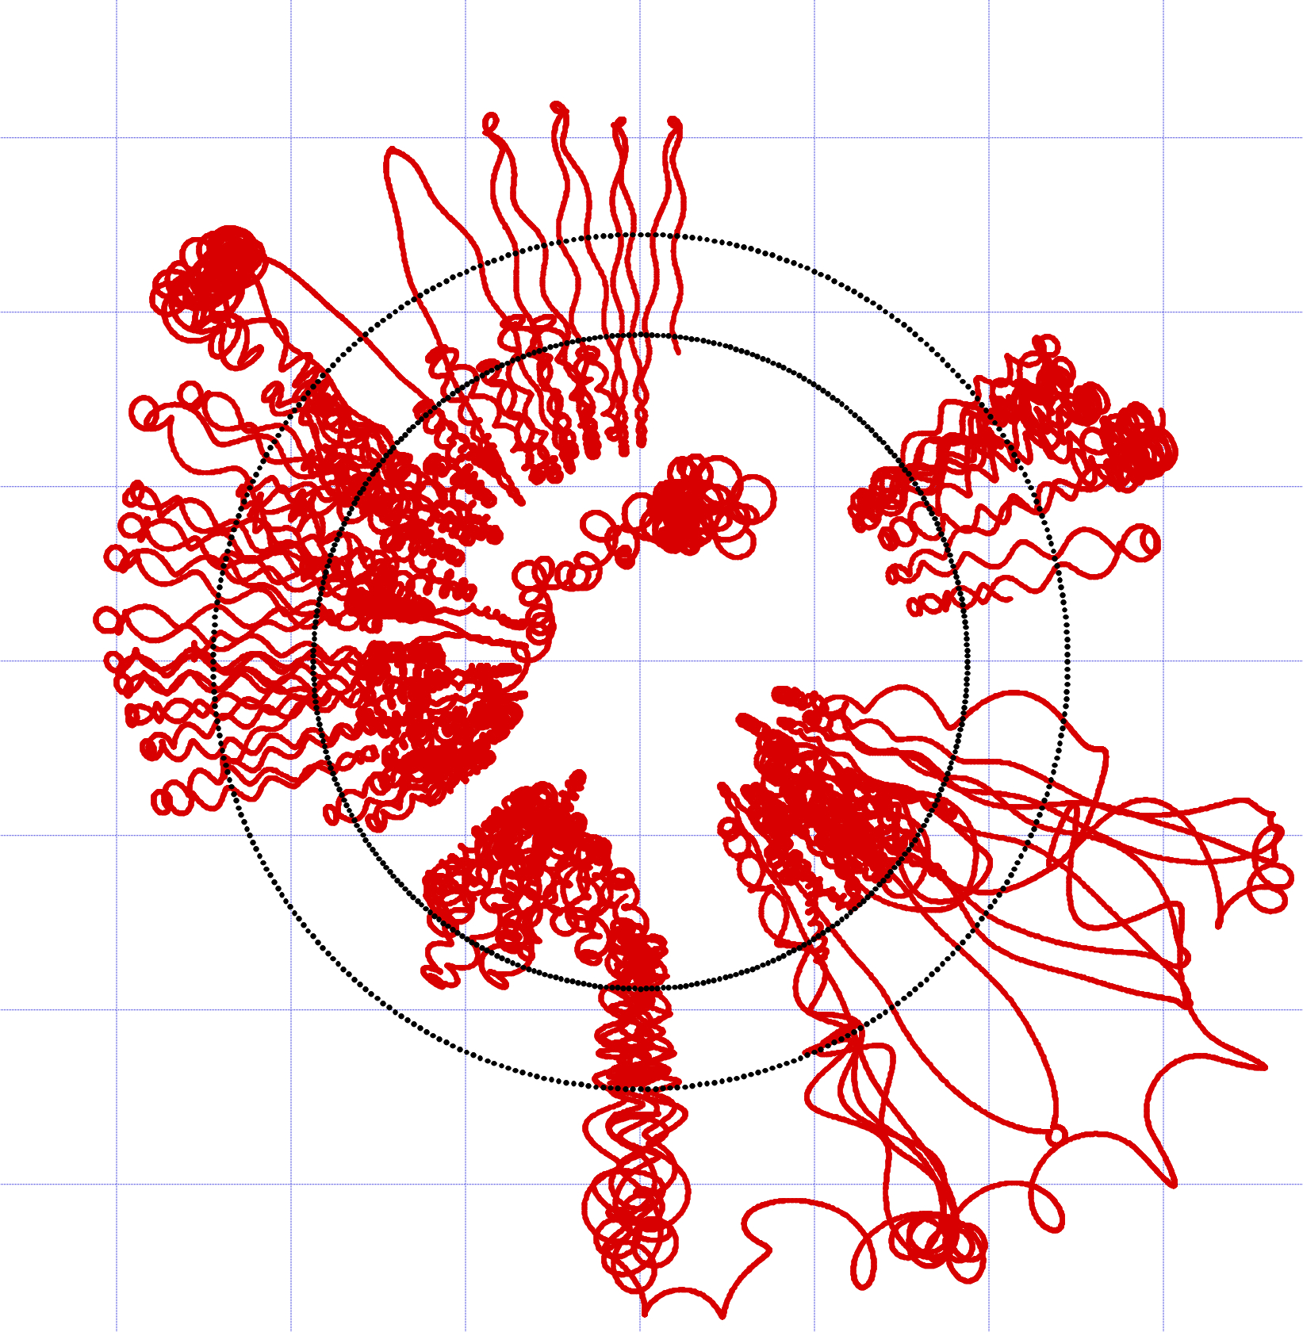

3D PIC-MCC
Model of
Hall Thruster
Francesco Taccogna
Pierpaolo Minelli
P.Las.M.I. research group
Istituto di Nanotecnologia
Consiglio Nazionale delle Ricerche
Bari
e-mail: francesco.taccogna@cnr.it ExB Plasmas for Space and Industrial Applications – Toulouse 23/06/2017

Slide 2
Outline
Critical Points in Hall Thruster
- Evidences from models / experiments
PIC-MCC Model
- Evolution of reduced-dimensional models -> lessons learned
- Modules of PIC-MCC cycle
- Requirements for a 3D representation / Geometrical scaling
Results
- 3D map of electric potential / electron density -> ECD instability
- Electron current density vector plot -> complex transport

Slide 3
Critical Points - Evidences in HT
Plasma has a strong kinetic behaviour:
low collisionality
pronounced anisotropy
Possible non-classical sheath behavior:
strong secondary electron emission -> material wall dependence
2D sheaths due to azimuthal drift (1D instability is transported along Hall-direction)
Anomalous Electron cross-field transport:
different mechanisms involved; wall-induced, fluctuation-induced, instability-induced, kinetic-induced
how to discern the incidence of each contribution
Strong correlations among the 3 dimensions:
Azimuthal modulation shows axial component
Cathode location
Electron cooling in expansion plume

Slide 4
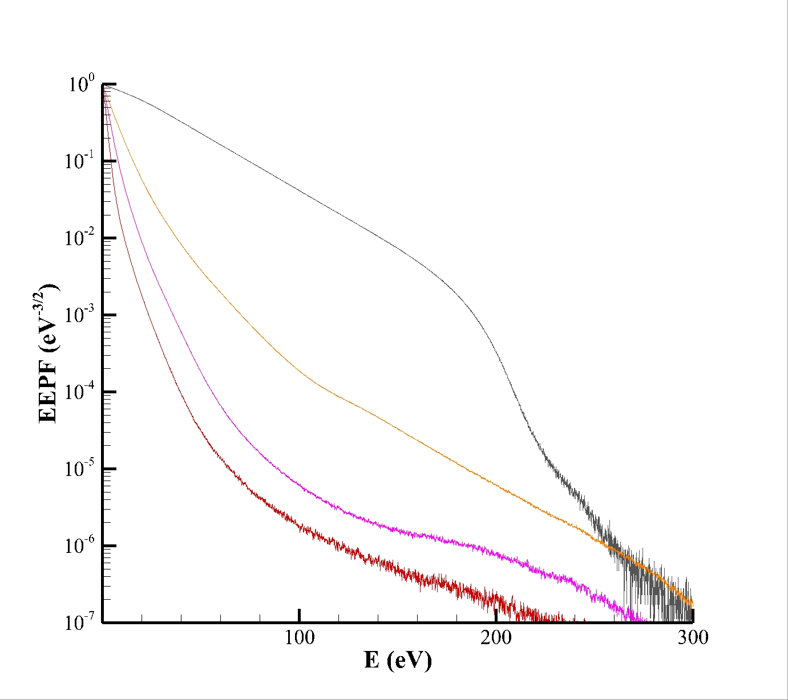
Evidences – Electron Energy Probability Function

Slide 5
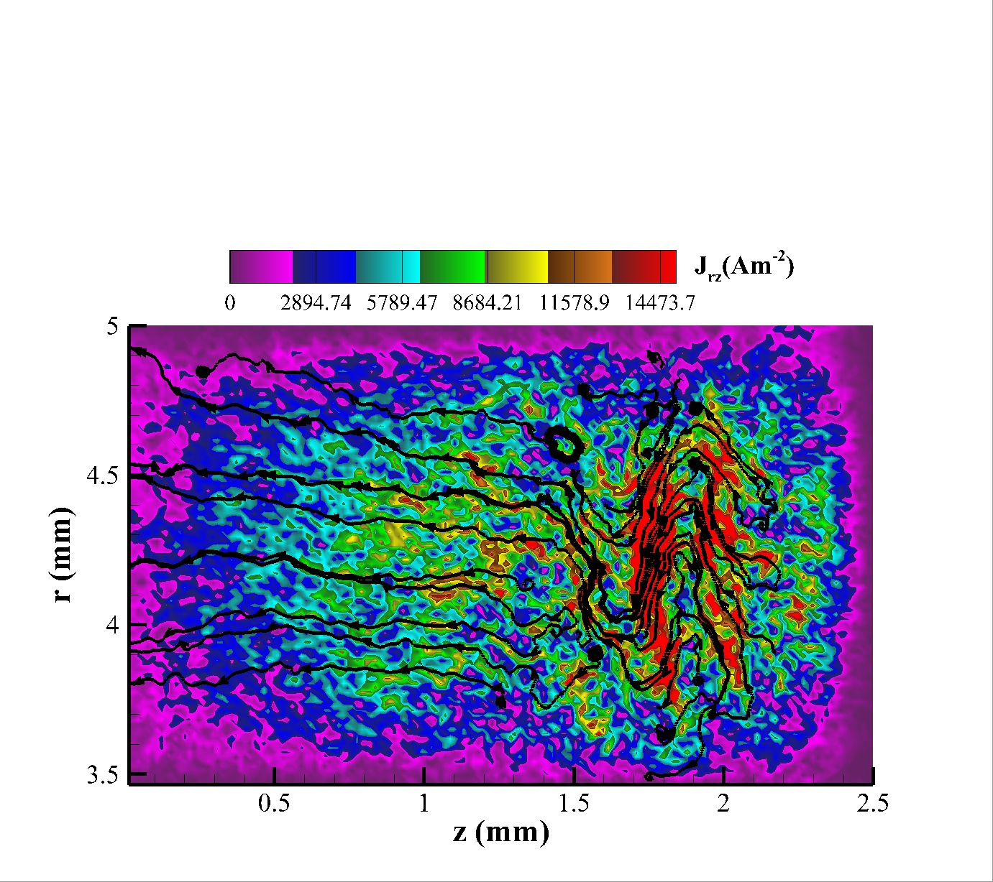
Evidences – Electron Current Density Map/Arrow Plot
(J_{r}²+J_{z}²)^{1/2}

Slide 6
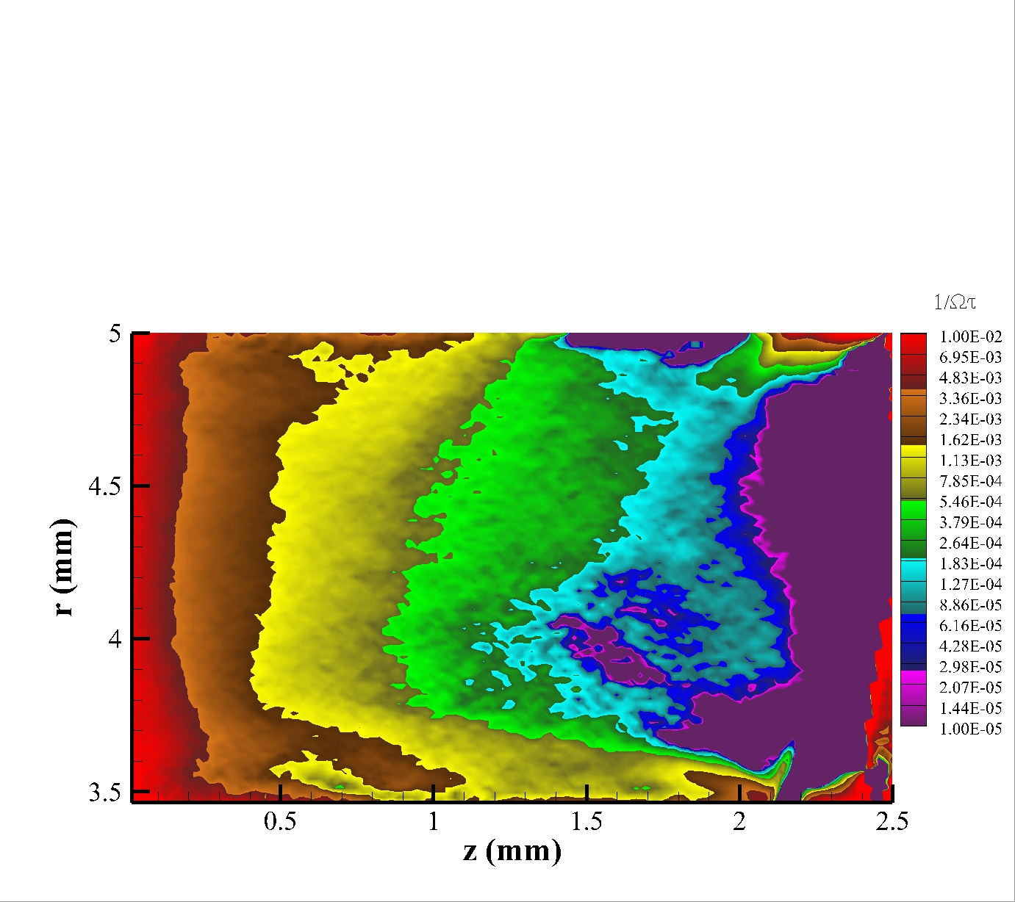
Evidences – Inverse Hall Parameter Map

Slide 7
Fully Kinetic HT Models
Model | Year | Assumptions | Findings
1D(r) - channel | 2006 | - Injection: control number; - E_{z}; | SEE-instability
2D(r,z) - channel | 2003 |  | acceleration mechanism
2D(r,θ) - channel | 2007 | - Injection: control number; - E_{z}; | r-θ correlation
3D(r,θ,z) - channel | 2011 | - geometrical scaling
3D(x,y,z) - near-field plume | 2013 | - geometrical scaling
3D(x,y,z) - channel+NFP | 2015 | - geometrical scaling
Balance between consistency and reductionism

Slide 8
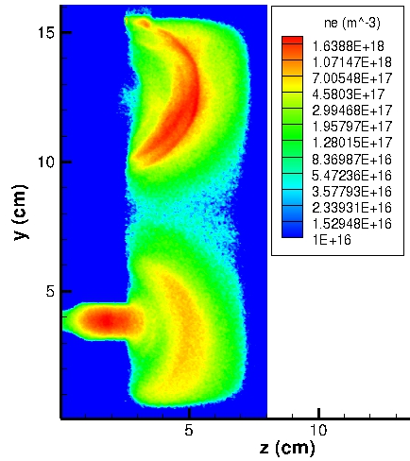
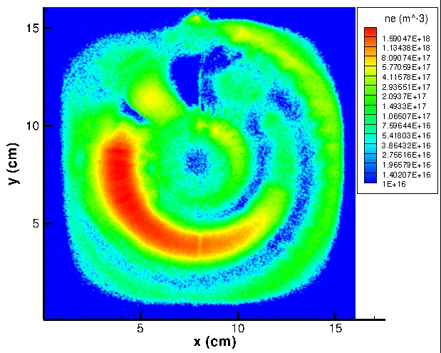
Fully Kinetic HT Models
Model | Year | Assumptions | Findings
1D(r) - channel | 2006 | - Injection: control number; - E_{z}; | SEE-instability
2D(r,z) - channel | 2003 |  | acceleration mechanism
2D(r,θ) - channel | 2007 | - Injection: control number; - E_{z}; | r-θ correlation
3D(r,θ,z) - channel | 2011 | - geometrical scaling
3D(x,y,z) - near-field plume | 2013 | - geometrical scaling
3D(x,y,z) - channel+NFP | 2015 | - geometrical scaling

Slide 9
3D(r,θ,z) Model
3D(r,θ,z) / discharge channel
- Domain: - radial from inner to outer wall;
- azimuthal: π/2
- axial from anode to exit plane
- Initial condition: start from scratch
- Injection condition: steady-state electron current control method from exit plane
- Field solve: Dielectric surface conductivity neglected
- Electron-atom MCC module
- electron-wall SEE module (Furman-Pivi model)
- Realistic ion mass, vacuum permittivity
- Assumption: - fixed potential (cathode) at the exit plane
- geometrical scaling (f=0.1)
- fixed non-uniform neutral map (no ionization instability)
- Numerical parameter: - N_{g}=N_{r}xN_{θ}xN_{z}=100x128x160 (grid points)
- N_{p}/N_{g}=30 (particles per cell)
- w=10³
- dt=2x10⁻¹² s

Slide 10
3D(r,θ,z) Geometrical Scaling
Reduction of size L keeping constant most relevant non-dimensional parameters:
Ionization
the discharge still keeps its plasma characteristics:
Confinement
(low collisionality)
(global quasi-neutrlity)
(unmagnetized sheath)
(unmagnetized ion)
(gradient driven instability)
(instability growth > ion convection)
Length | L = f L*
Magnetic field | B = f⁻¹ B*
Neutral density | n_{g} =f⁻¹ n_{g}*
Current | I_{D} = f⁻² I_{D}*
- S/V changes
- Gradient lenghts scale change
f=0.1

Slide 11
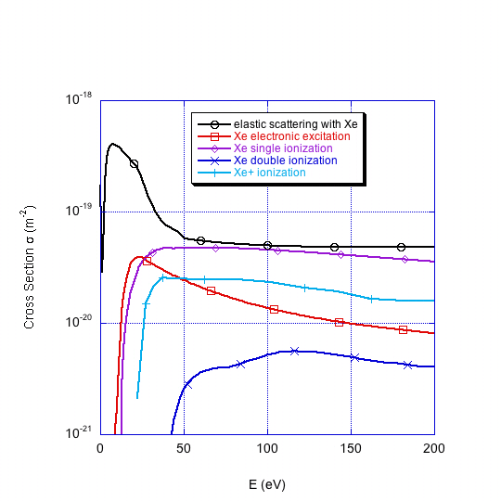
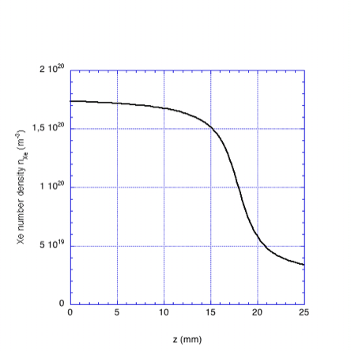
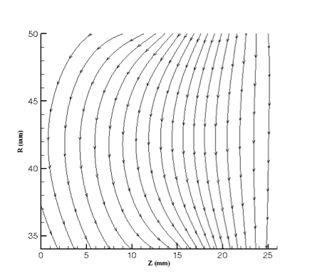
Operative Conditions
Column length | L = 2.5 cm
Internal cylinder radius | R_{in} = 3.5 cm
External cylinder radius | R_{out} = 5 cm
Propellant mass flow rate | dm/dt = 4 mg/s
Input power | P = 1350 W
Discharge voltage | V_{d} = 300 V
Discharge current | I_{d} = 4.5 A
Max radial magnetic field | B_{r,max} = 150 G
SPT-100

Slide 12
Results – Global Quantities
I_{se}=0.026 A
OUTER WALL
I_{e}=0.032 A
I_{e}=0.05 A
I_{i}=0.035 A
ANODE
EXIT PLANE
I_{e}=0.022 A
INNER WALL
I_{se}=0.016 A

Slide 13
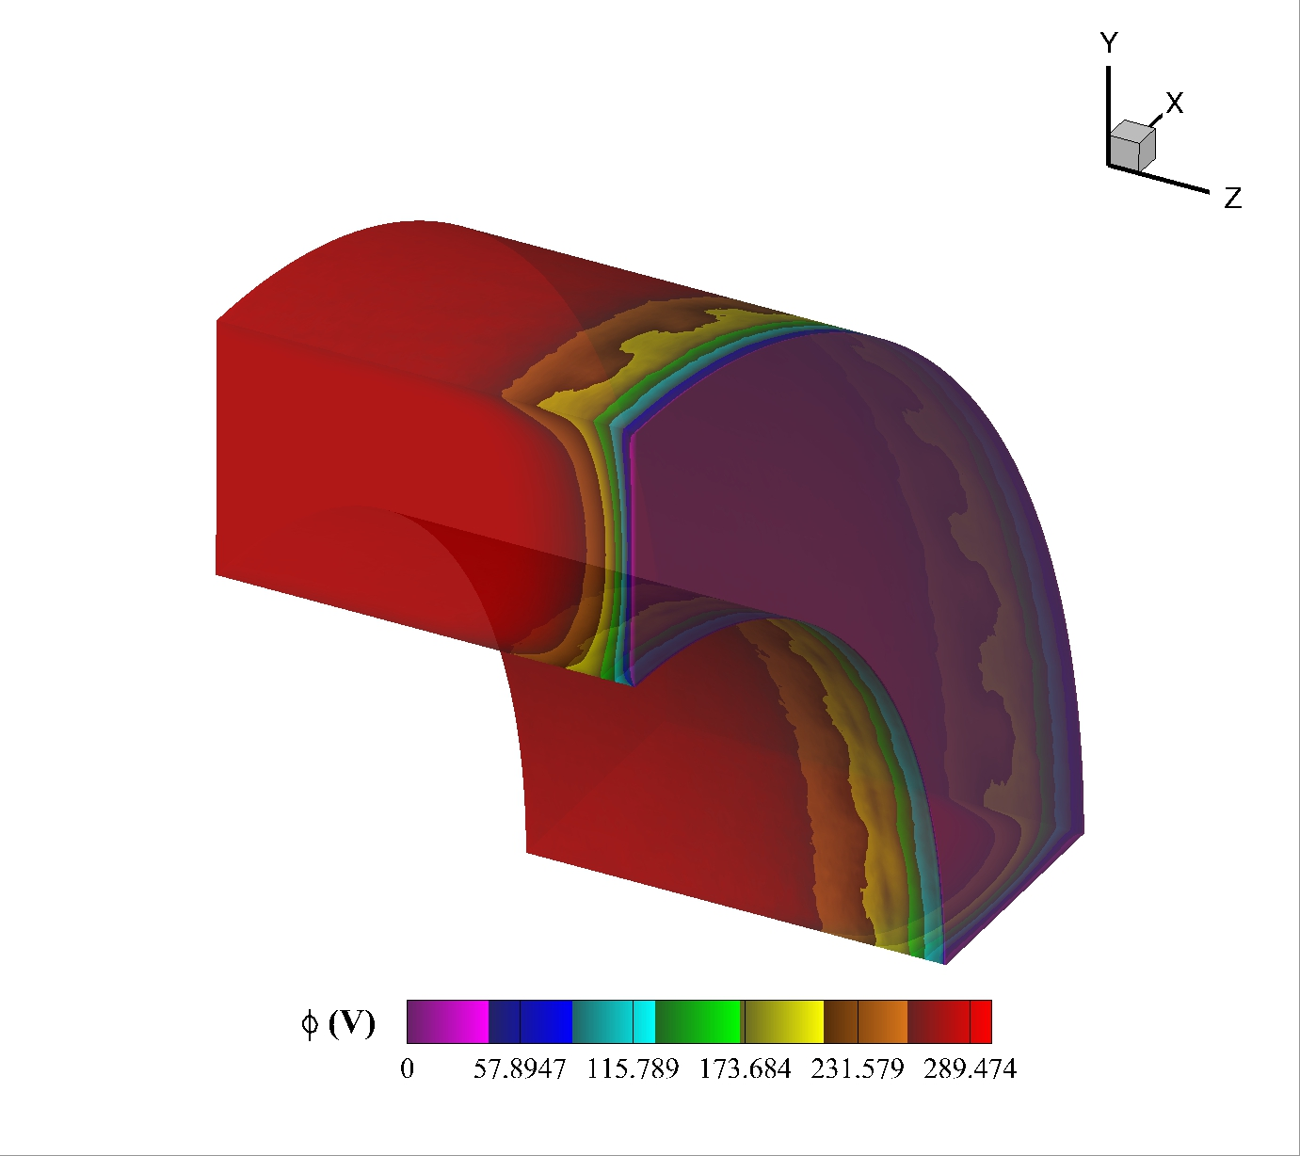
Results – 3D Electric Potential Map

Slide 14
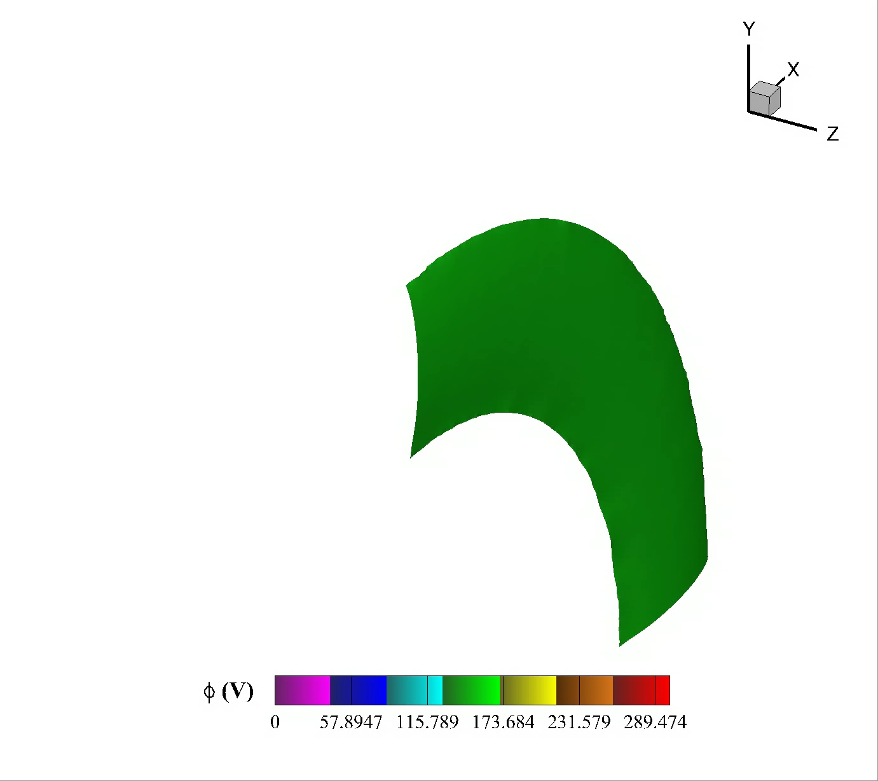
Results – 3D Electric Potential Isosurface

Slide 15
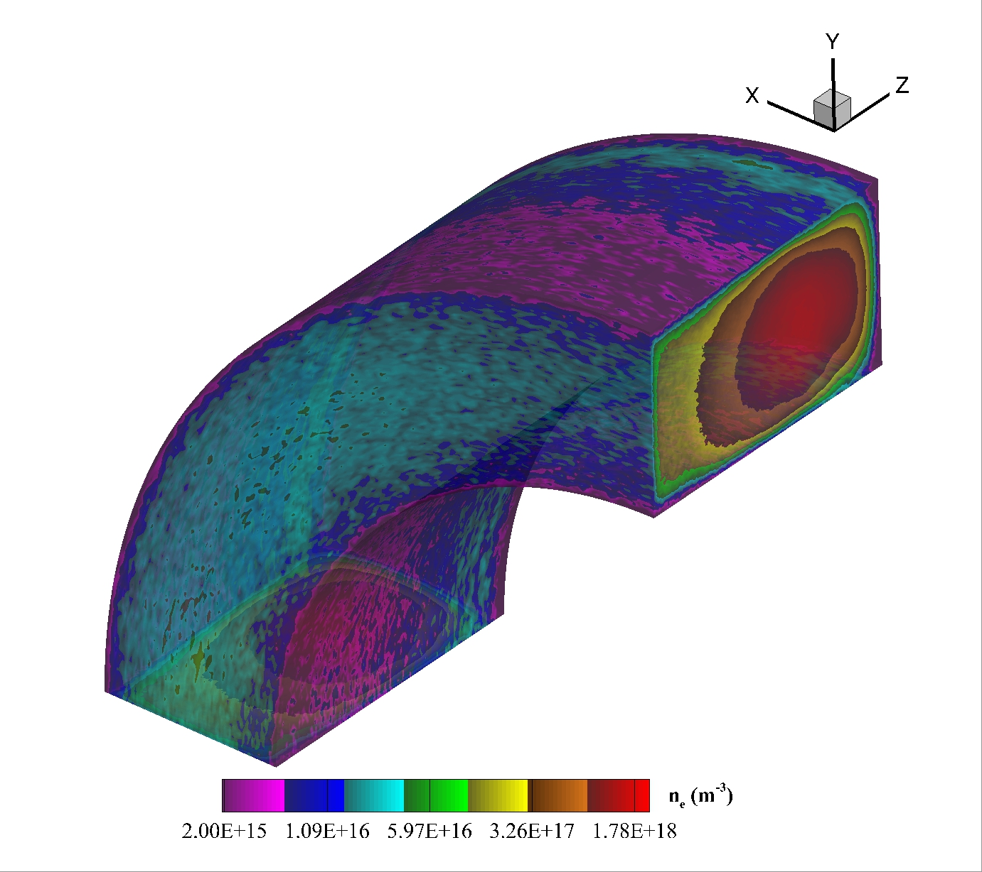
Results – 3D Electron Density Map

Slide 16
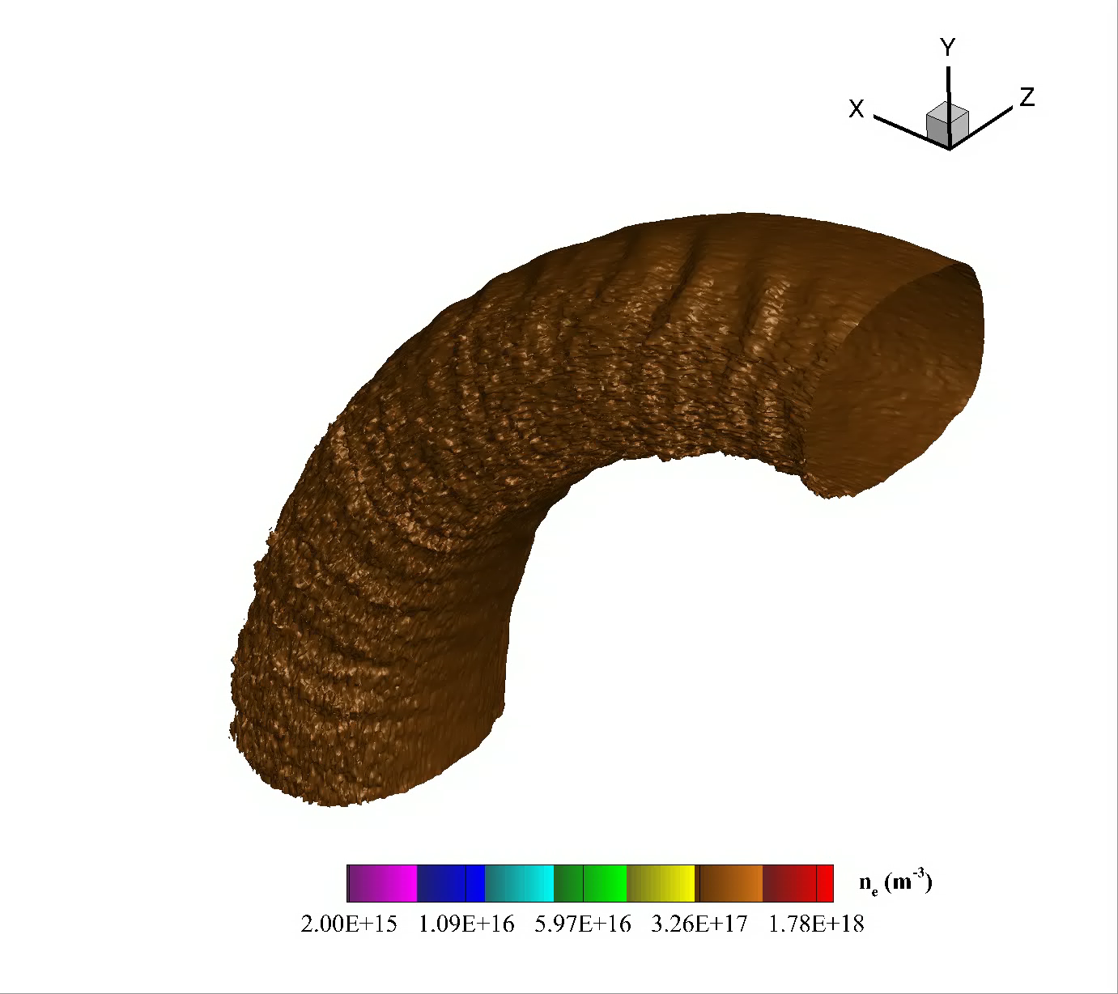
Results – 3D Electron Density Isosurface

Slide 17
Results – 2D Electron Current Density Map-Arrow Plot
averaged over θ
(J_{r}²+J_{z}²)^{1/2} (A/m²)

Slide 18
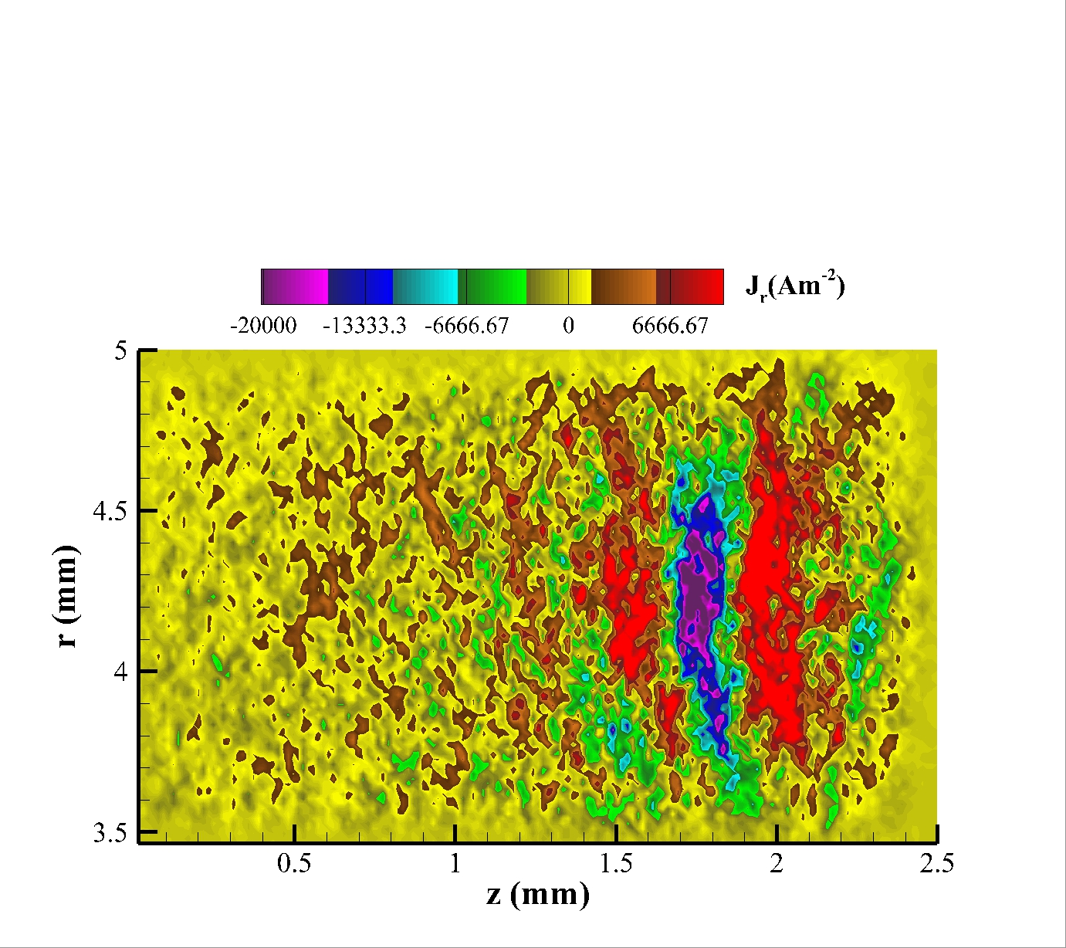
Results – 2D Electron Current Density Map
averaged over θ

Slide 19
Results – 2D Electron Current Density Map
averaged over θ

Slide 20
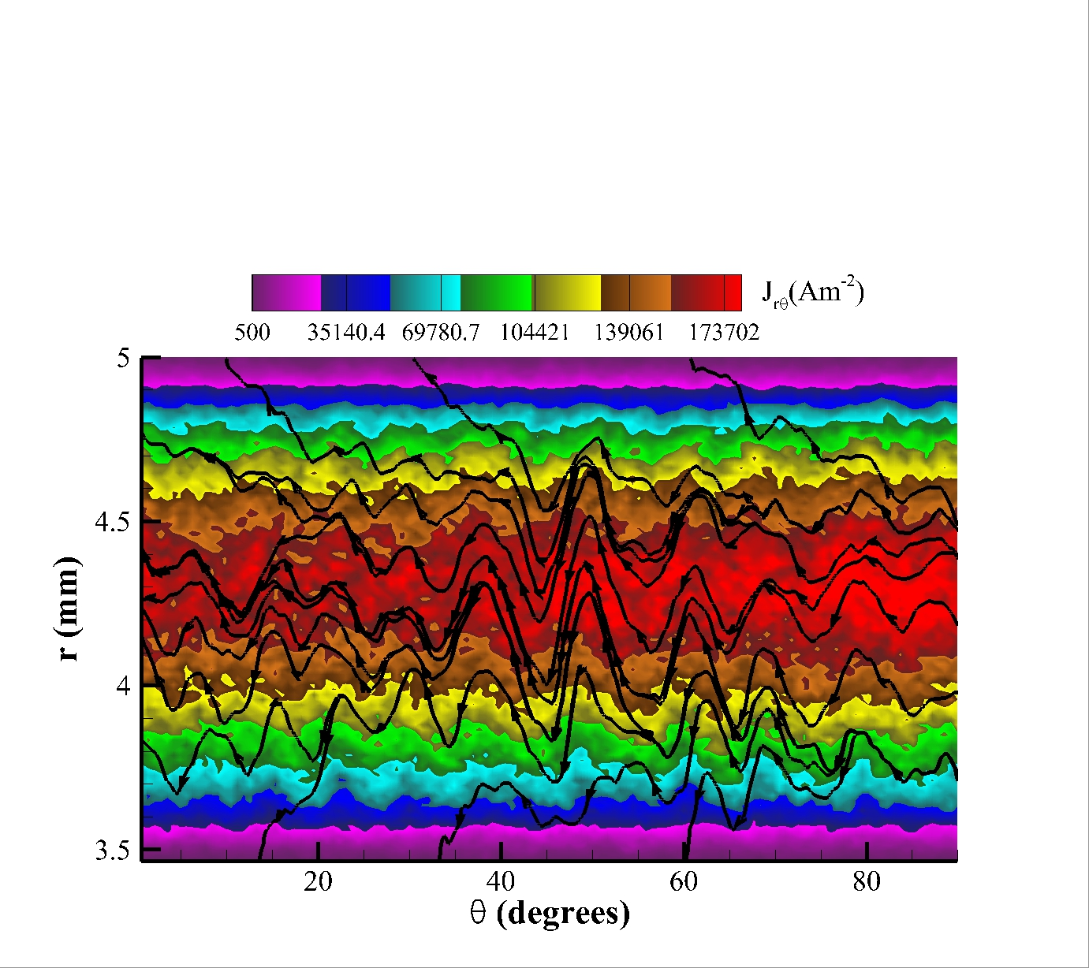
Results – 2D Electron Current Density Map-Arrow Plot
@ z = 2 mm
(J_{r}²+J_{θ}²)^{1/2} (A/m²)

Slide 21
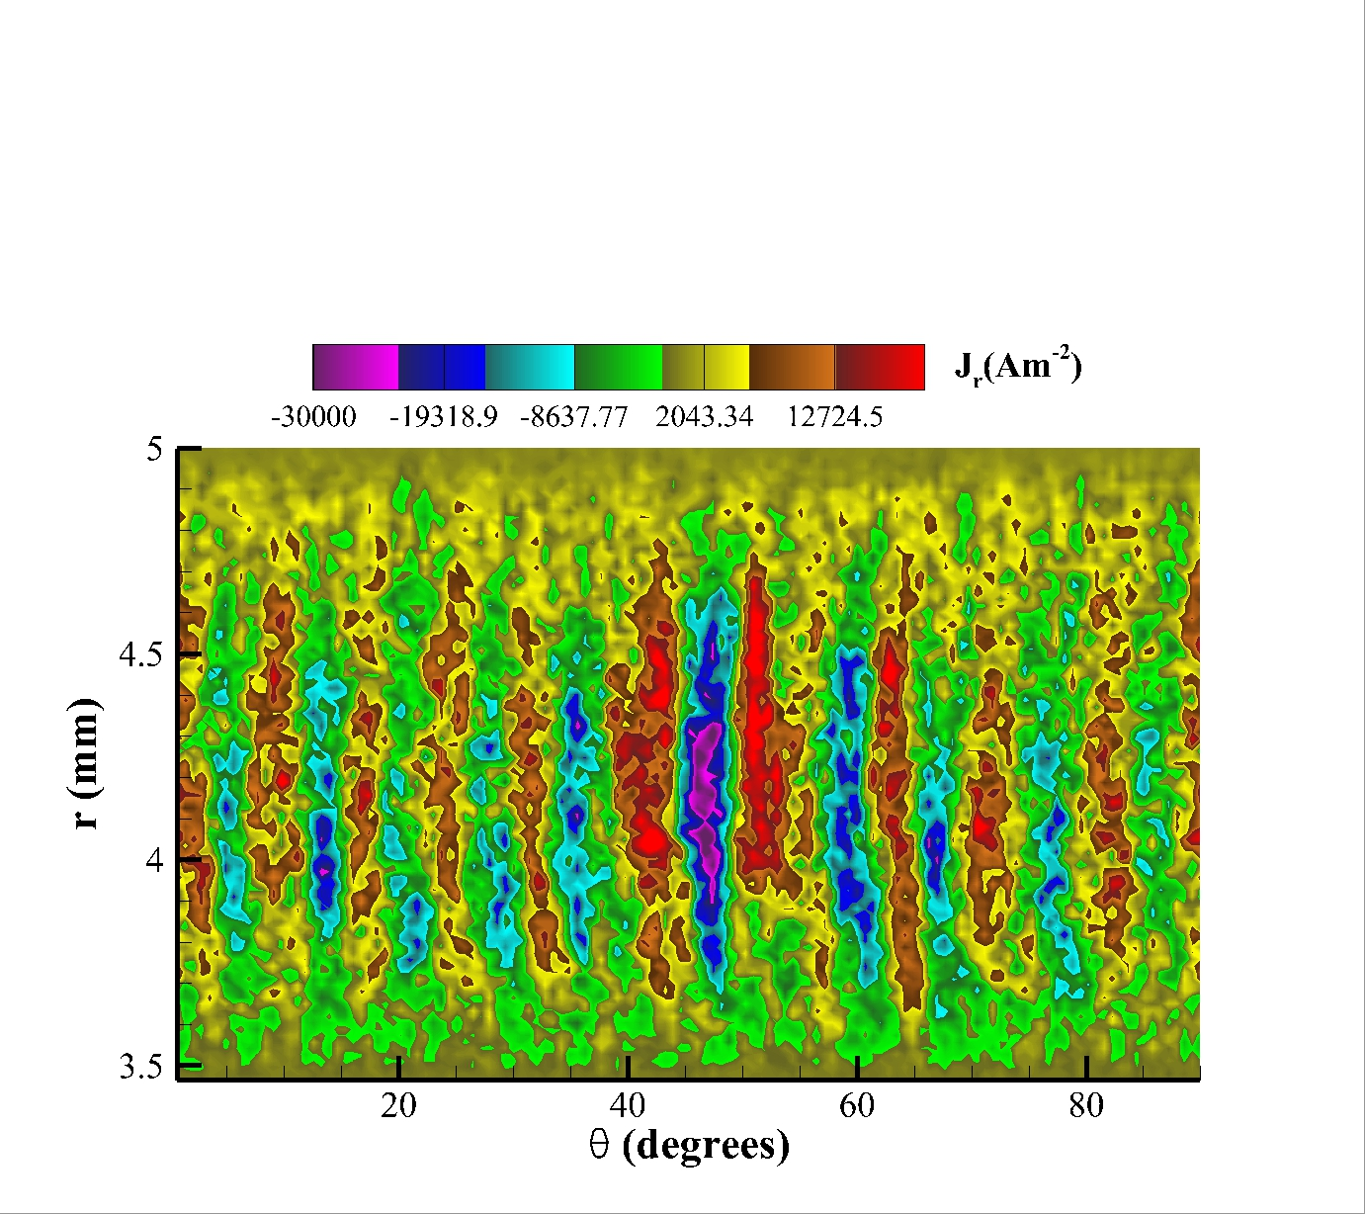
Results – 2D Electron Current Density Map
@ z = 2 mm

Slide 22
Results – 2D Electron Current Density Map
@ z = 2 mm

Slide 23
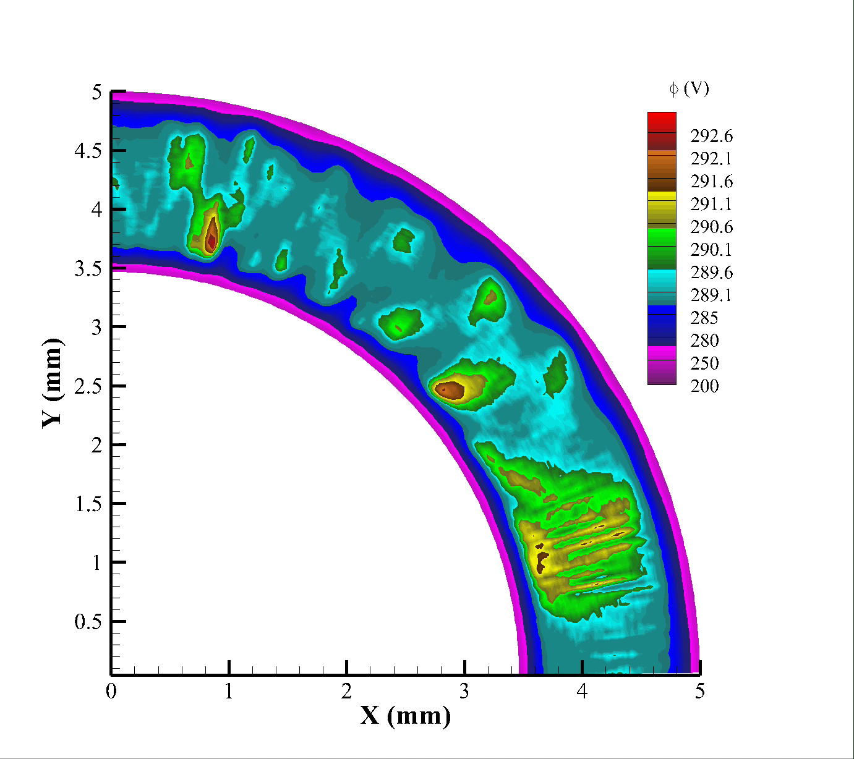
Results – 2D Electric Potential Movie
@ z = 2 mm
Δt=20 ns

Slide 24
Conclusions
Critical Points in Hall Thruster
- Evidences from models / experiments ->
necessity of kinetic/multidimensional representation
PIC-MCC Model
- Evolution of reduced-dimensional models -> lession learned
- Geometrical scaling
Results
- 3D map of electric potential / electron density -> ECD instability
- Electron current density vector plot -> complex transport
- Indirect influence of the wall on the electron transport

