Slide 1
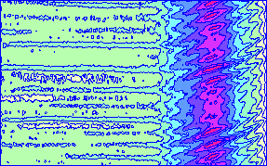
Software and diagnostics for the study of instabilities in partially magnetized plasmas
Edgar Y. Choueiri and Sebastián Rojas Mata
E$×$B Plasmas for Space and Industrial Applications
21-23 June 2017, Toulouse, France

Slide 2
Outline
Numerical Work: Plasma Rocket Instability Characterizer (PRINCE)
Experimental Validation: Active Wave Injection (AWI) Diagnostic
Current Work: Validating Study

Slide 3
Numerical Work

Slide 4
Interactive Software Tool
Plasma Rocket Instability Characterizer (PRINCE)
Versatile data input
Parametric control of solver settings
Robust root-solving algorithms
Data visualization features

Slide 5
PRINCE Overview
$$Re[ω]$$
$$n_{e}, T_{e}, B, φ, …$$
$$ω_{min}≤ω≤ω_{max}$$
$$k_{min}≤k≤k_{max}$$
$$𝔇\left(ω, k;p_{1}, p_{2},…\right)=0$$
$$k$$
$$Im[ω]$$
$$k$$
Input
Find
Track

Slide 6
Root-Solving Algorithms
Global root-finder¹
For each spatial point, how many zeros are there and what are their locations in the complex plane?
[1] Choueiri 1991

Slide 7
Application of Cauchy’s Argument Principle
$$ℛ$$
$$×$$
$$I_{t}= \frac{1}{2πi}\oint_{γ}{ζ^{t}\frac{𝔇′(ζ)}{𝔇(ζ)}dζ}$$
$$×$$
$$×$$
$$⋅$$
$I_{0}$: Sum of multiplicities of zeros
$$Im[z]$$
$$γ$$
$I_{1}$: Value of zero times multiplicity (if only one present)
$$Re[z]$$

Slide 8
Global Search Algorithm
$$Im[ω]$$
$$I_{0}=1$$
$$I_{0}=2$$
$$Re[ω]$$

Slide 9
Global Search Algorithm
$$Im[ω]$$
$$Re[ω]$$

Slide 10
Root-Solving Algorithms
Global root-finder¹
For each spatial point, how many zeros are there and what are their locations in the complex plane?
Local root-tracker
What is the dependence of the zeros on the iteration variable?
[1] Choueiri 1991

Slide 11
Local Root-Tracker
$$𝔇\left(ω,k_{j+1}\right),ω_{j}$$
$$ω_{j}$$
$$ω_{j+1}$$
$$Δk$$
$$Im[ω]$$
Newton-Raphson’s method
$$Re[ω]$$
$$ω_{j+1}$$

Slide 12
Example using PRINCE

Slide 13
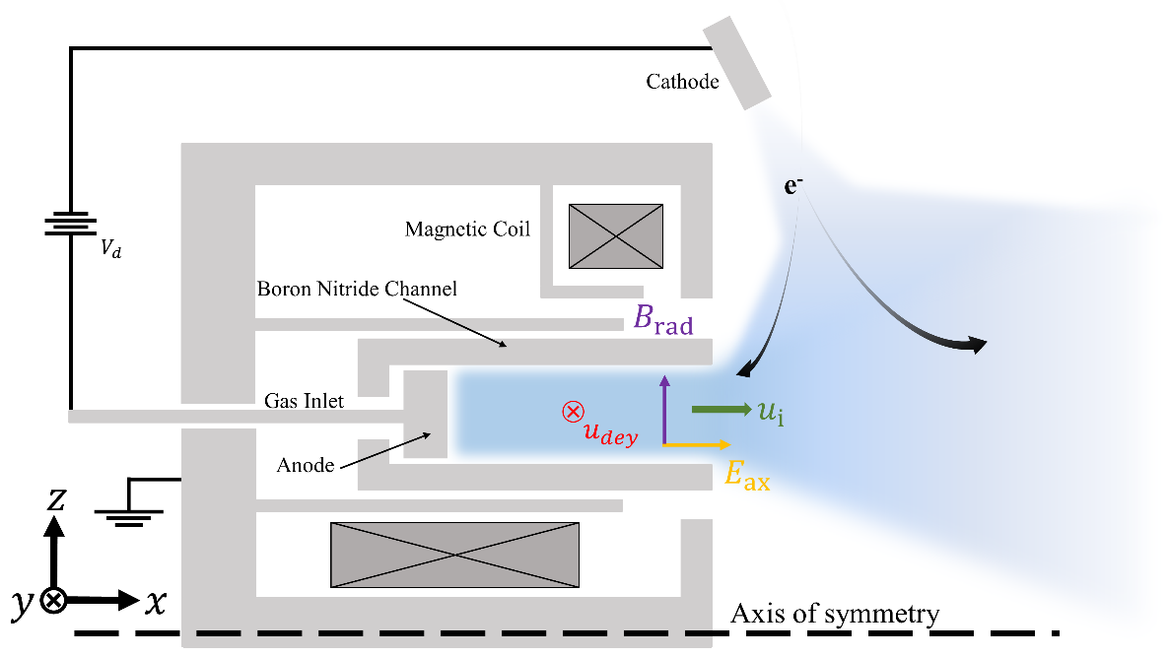
Input: 1-D Spatial maps of plasma parameters

Slide 14
Input: 2-D Spatial maps of plasma parameters

Slide 15
PRINCE Example: Esipchuk-Tilinin Dispersion Relation¹
Two-fluid, collisionless, unmagnetized ions, $ω_{ci}≪ω≪ω_{ce}, ω_{pe}$
$$\frac{1}{ω_{pi}^{2}}−\frac{1}{{\left(ω−k_{x}u_{i}\right)}^{2}}+\frac{1}{ω_{ci}ω_{ce}}+\frac{1}{k_{⊥}^{2}v_{A}^{2}}−\frac{k_{y}\left(u_{dey}−u_{B}\right)}{{k_{⊥}^{2}u}_{i}^{2}\left(ω−k_{y}u_{dey}\right)}=0$$
Further assumptions²:${{\left(ω−k_{x}u_{i}\right)}^{2}≪ω}_{ci}ω_{ce}≪ω_{pi}^{2}, {\left(ω−k_{x}u_{i}\right)}^{2}≪k_{⊥}^{2}v_{A}^{2}$
$$⇒ \frac{1}{{\left(ω−k_{x}u_{i}\right)}^{2}}+\frac{k_{y}\left(u_{dey}−u_{B}\right)}{k_{⊥}^{2}u_{i}^{2}\left(ω−k_{y}u_{dey}\right)}=0$$
[1] Esipchuk, Tilinin 1976 [2] Choueiri 2001

Slide 16
Run Prince

Slide 17
PRINCE Example
Unstable
Stable

Slide 18
Updates on PRINCE
Developing open-source desktop app
GitHub Electron (open-source framework)
Chromium for front-end
Node.js for back-end
Run code on native machine
Cross-platform and portable
Download and use on Windows, Mac and Unix machines

Slide 19
Updates on PRINCE
Front end: HTML/JavaScript-based GUI
Back end: Parallelizable native C++ code using GNU Scientific Library (GSL) functions
Current Status (implemented)
Functional GUI with data import
Internal data parsing and symbolic aliasing
Simple plotting routines
GSL
Collaborator: José María Rico Chinchilla (COS ‘18)

Slide 20
Experimental Verification

Slide 21
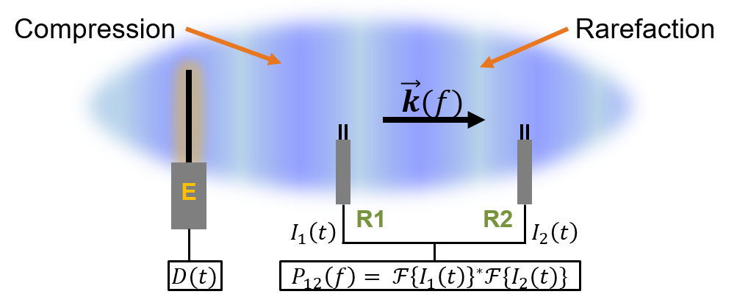
Active Wave Injection

Slide 22
AWI Diagnostic
High signal-to-noise ratio measurements
Control over harmonic content of wave modes
Relatively inexpensive
Drawback: intrusive

Slide 23
Fourier-Space Quantities
Fourier transforms
${\hat{I}}_{1}\left(f\right)={ℱ\{I}_{1}\left(t\right)\}, {\hat{I}}_{2}\left(f\right)={ℱ\{I}_{2}\left(t\right)\}$
Power spectra
$P_{11}\left(f\right)={\hat{I}}_{1}^{∗}\left(f\right){\hat{I}}_{1}\left(f\right), P_{22}\left(f\right)={\hat{I}}_{2}^{∗}\left(f\right){\hat{I}}_{2}\left(f\right)$
Cross spectrum
$P_{12}\left(f\right)={\hat{I}}_{1}^{∗}\left(f\right){\hat{I}}_{2}(f)$
Coherence spectrum
$γ_{12}\left(f\right)= \frac{P_{12}(f)}{{\left[P_{11}\left(f\right)P_{22}\left(f\right)\right]}^{1/2}}$

Slide 24
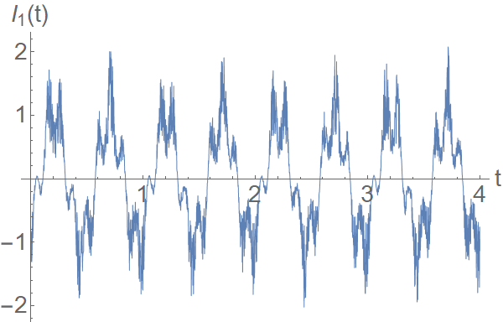
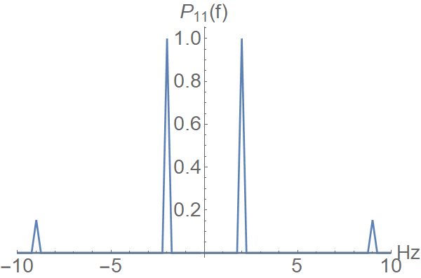
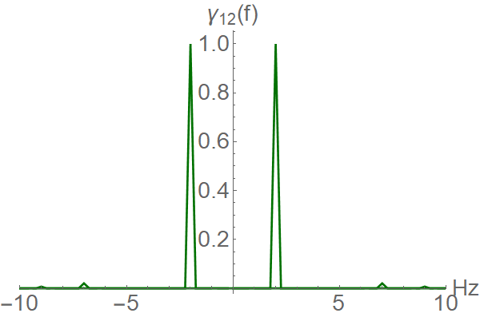
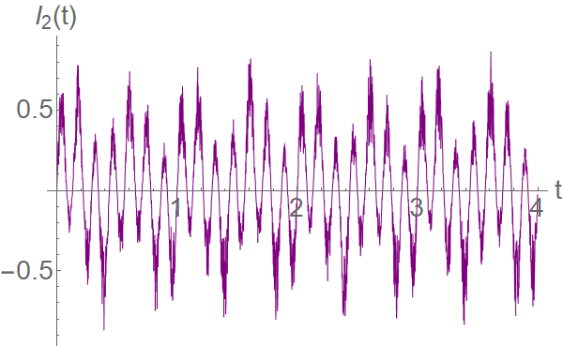
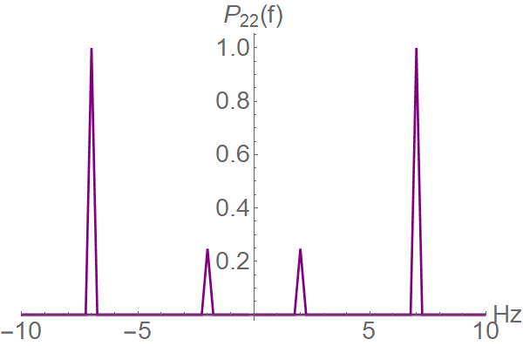
Interferometric Analysis
$$γ_{12}\left(f\right)$$
$$I_{1}\left(t\right)$$
$$P_{11}(f)$$
$$I_{2}\left(t\right)$$
$$P_{22}(f)$$
Signals are coherent
$→$ Travelling wave

Slide 25
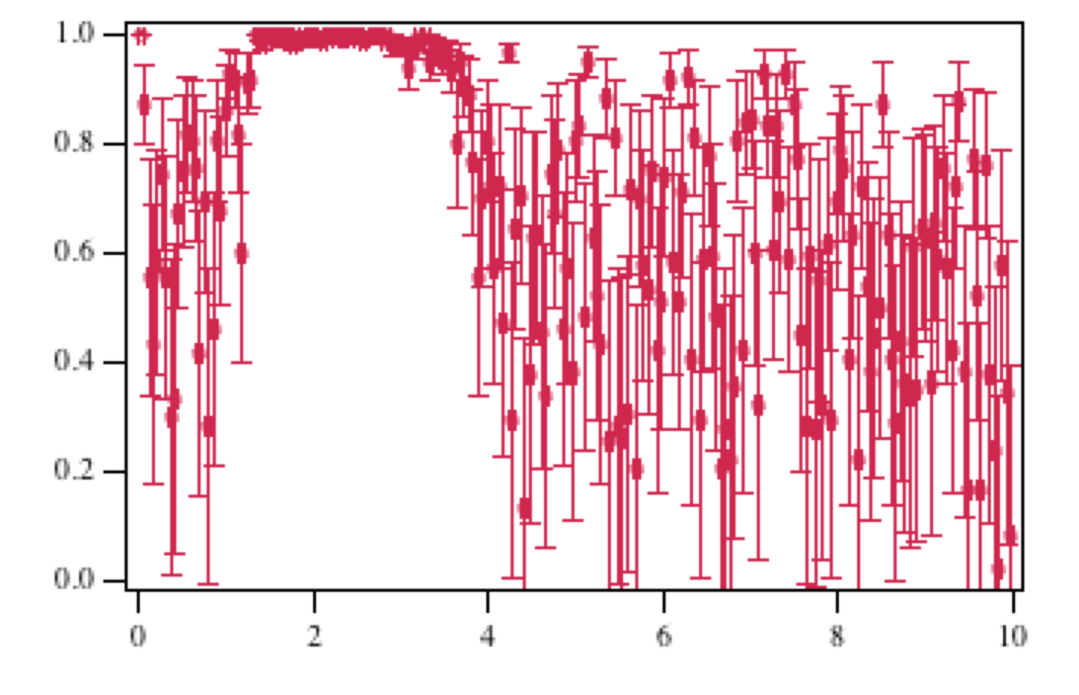
PWX : Coherence Spectrum
Coherence
Frequency (MHz)

Slide 26
Dispersion Relation from AWI
Real part of the dispersion relation
$k\left(f\right)=\arg\left\{P_{12}\left(f\right)\right\}/d_{12}=Δθ_{12}\left(f\right)$/$d_{12}$
$d_{12}$ - Distance between probes
Phase velocity spectrum
$v_{ph}\left(f\right)= \frac{2πf}{k(f)}$
Attenuation/growth spectrum
$A\left(f\right)= {|I_{2}(f)|}/{|I_{1}(f)|}$
Need to account for geometry
Smith et al. 1974 IEEE Transactions on Plasma Science

Slide 27
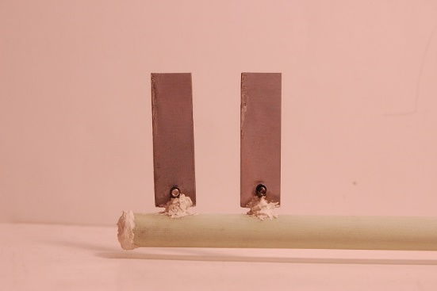
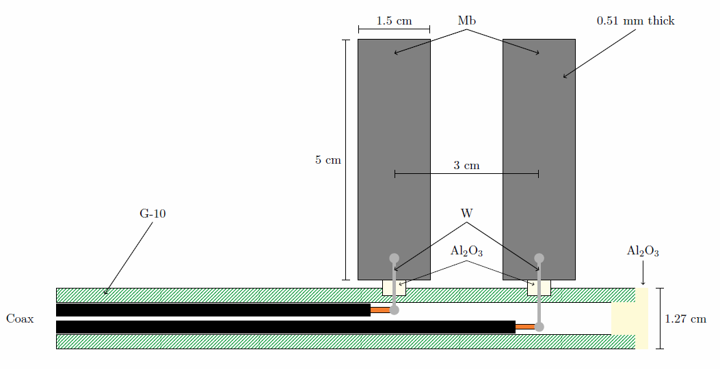
Wave Antenna

Slide 28
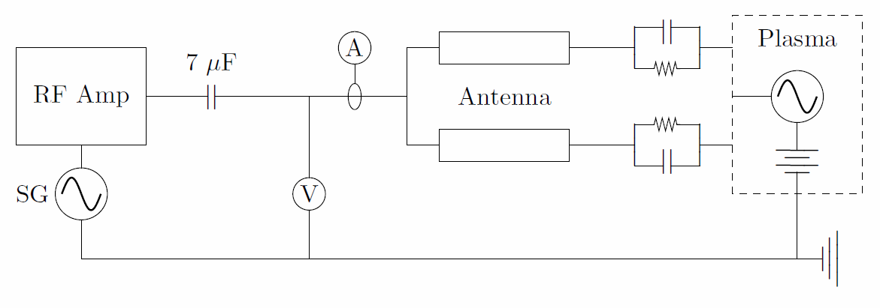
Antenna Circuit

Slide 29
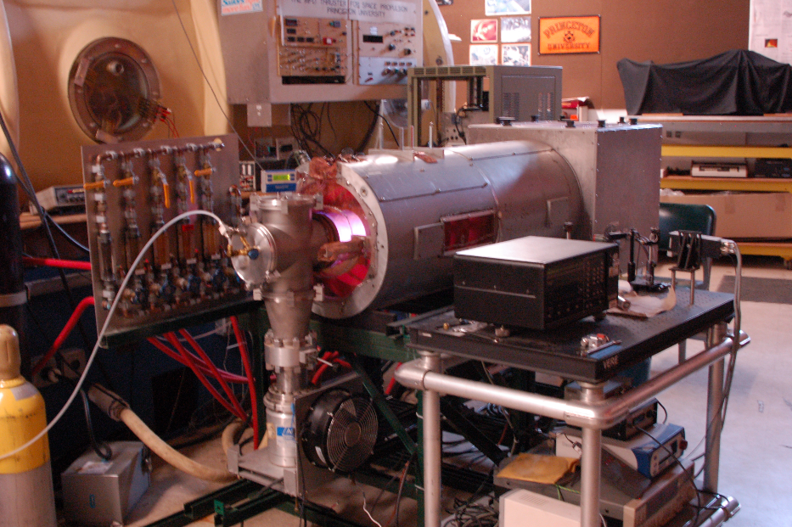
Experiment
13.56 MHz RF argon discharge
10 solenoid coils

Slide 30
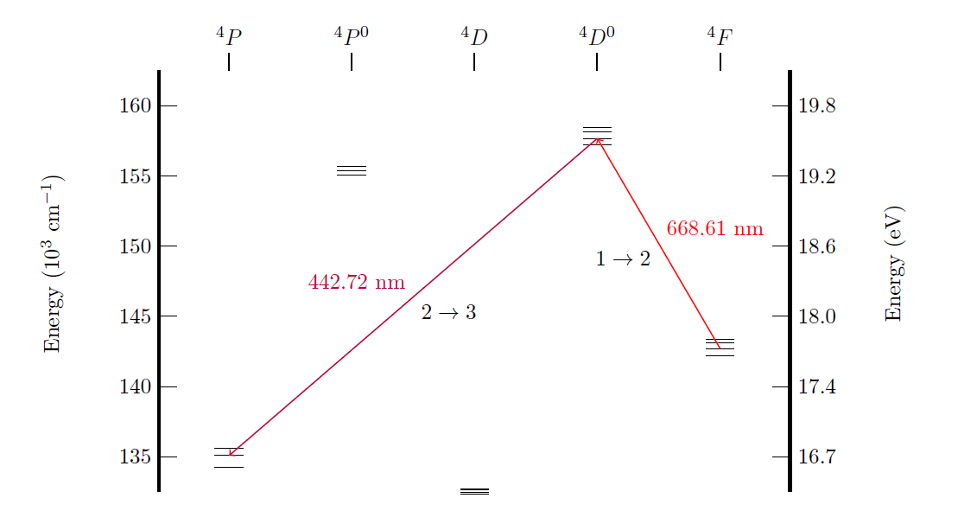
Laser Induced Fluorescence
Partial Ar II Grotrian Diagram

Slide 31
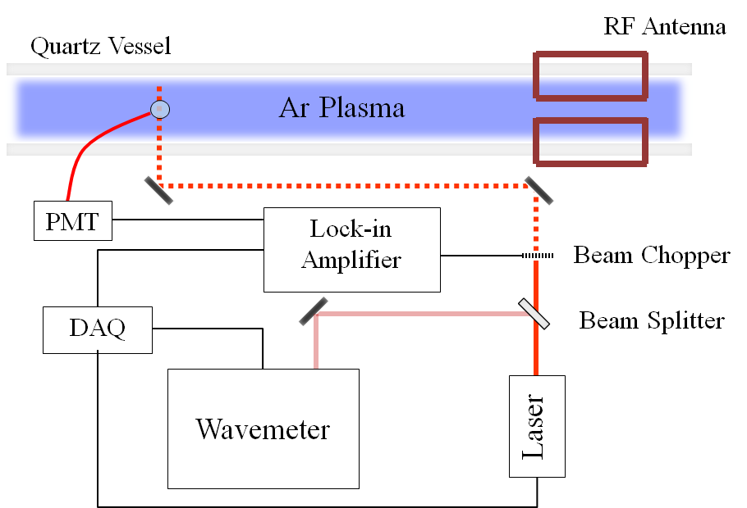
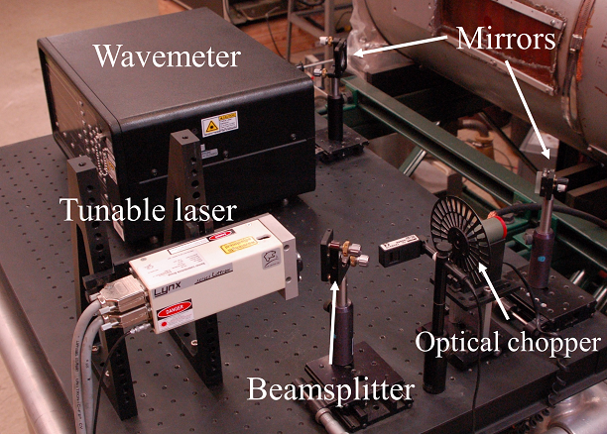
LIF System

Slide 32
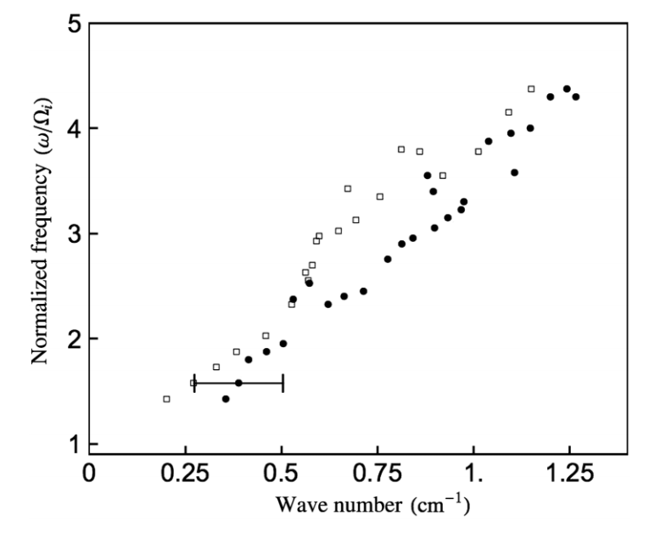
Sample Dispersion Data
$$k_{∥}$$
$$ω_{c,i}=2πf_{c, i}$$
$f_{c, i}=20$ kHz
$$k_{⊥}$$
Jorns, Choueiri PRL 2013

Slide 33
Conclusions
PRINCE software
Overview and example
Update on development
AWI Diagnostic
Theory and motivation
Wave launching antenna design
Validating Study
Electrostatic ion cyclotron waves in RF plasma
LIF benchmarking diagnostic

Slide 34
Background Distribution - $f_{0}$
Measure ion temperature and drift velocity
$$f_{0}\left(V\right)=n_{0}{\left(\frac{m_{i}}{2πT_{i}}\right)}^{1/2}e^{−m_{i}V^{2}/2T_{i}}$$
$$I\left(ν_{L}\right)=I_{0}e^{−{\left(ν_{L}−\overline{ν}\right)}^{2}/2σ^{2}}$$
$$\overline{ν}=ν_{0}\left(1+\frac{v_{d,i}}{c}\right), σ^{2}=\frac{ν_{0}^{2}T_{i}}{c^{2}m_{i}}, I_{0}∝{\left(\frac{m_{i}}{2πT_{i}}\right)}^{1/2}$$

Slide 35
Wave-Induced Perturbation - $f_{1}$
Measure dispersion relation of electrostatic wave
Record in-phase and out-of-phase components of fluorescence due to passing electrostatic wave
Fit analytical expression for $f_{1}$ to measured fluorescent intensity (next slide)
Derived from ion Vlasov equation with electrostatic wave perturbation
Determine best fit $k_{⊥}$ and $θ=\tan^{−1}\left(\frac{k_{y}}{k_{x}}\right)$

Slide 36
Analytical $f_{1}$ Expression
$$f_{1}= \frac{qΦ_{1}}{πm_{i}v_{ti⊥}^{2}} f_{0}\left(v_{x}\right)\sum_{n, m}{\left(1+Z\left(ζ_{n+m} \right)\left[ζ_{0}\frac{T_{∥}}{T_{⊥}}+\left(1−\frac{T_{∥}}{T_{⊥}}\right)Z\left(ζ_{n+m}\right)\right]\right)}$$
$$×{ J}_{m}\left(\frac{k_{⊥}v_{y}}{Ω_{i}}\right){e^{−imπ/2}e}^{i\left(m+n\right)θ}e^{ik_{y}v_{x}/Ω_{i}}e^{−a^{2}/8}e^{−c^{2}/4}\sum_{l}{I_{\frac{n+l}{2}}}\left(\frac{a^{2}}{8}\right)I_{l}\left(\frac{ac}{2}\right)e^{−ilπ/2}$$
$$ζ_{n}= \frac{ω−nΩ_{i}−k_{∥}v_{di}}{{k_{∥}v}_{ti∥}}, a= \frac{\sqrt{2}k_{⊥}v_{ti⊥}}{Ω_{i}}, c=\frac{\sqrt{2}k_{x}v_{ti⊥}}{Ω_{i}}$$
Remove $Φ_{1}$ dependence with normalization
Solve electrostatic dispersion relation for $k_{∥}(k_{⊥})$
Survey $(k_{⊥}, θ)$ space
Find best fit parameters through $χ^{2}$-analysis

Slide 37
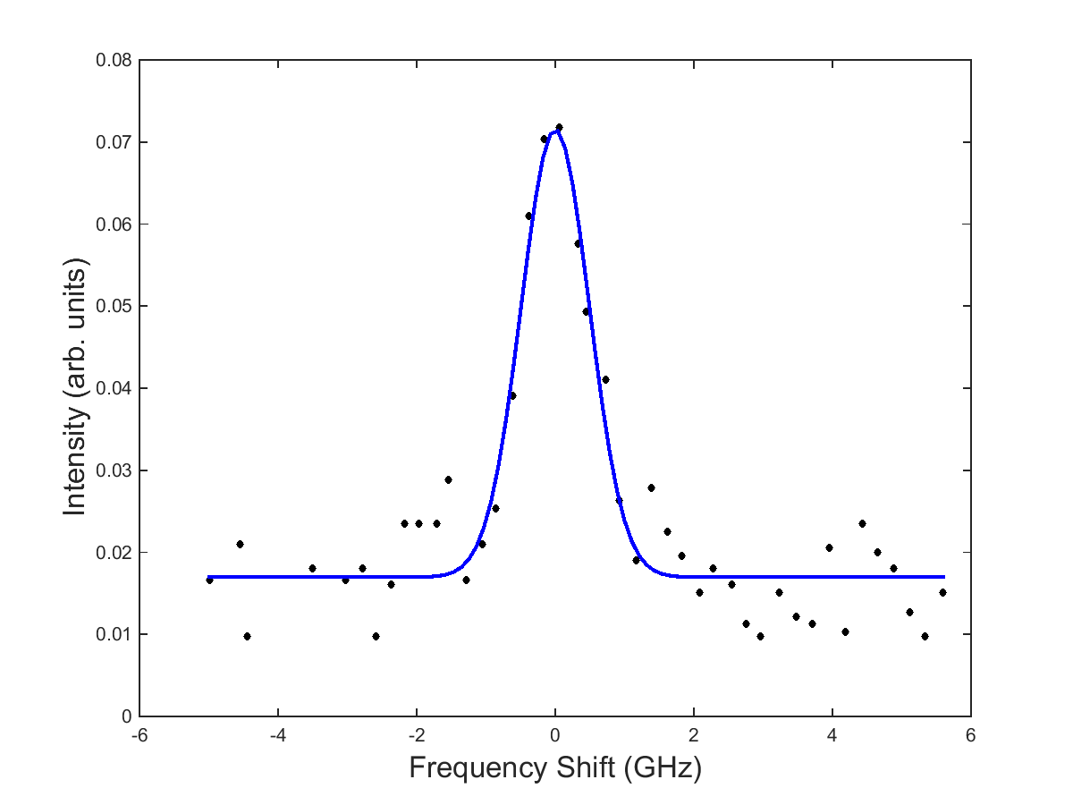
Sample Temperature Data
$T_{i}=0.04$ eV

Slide 38
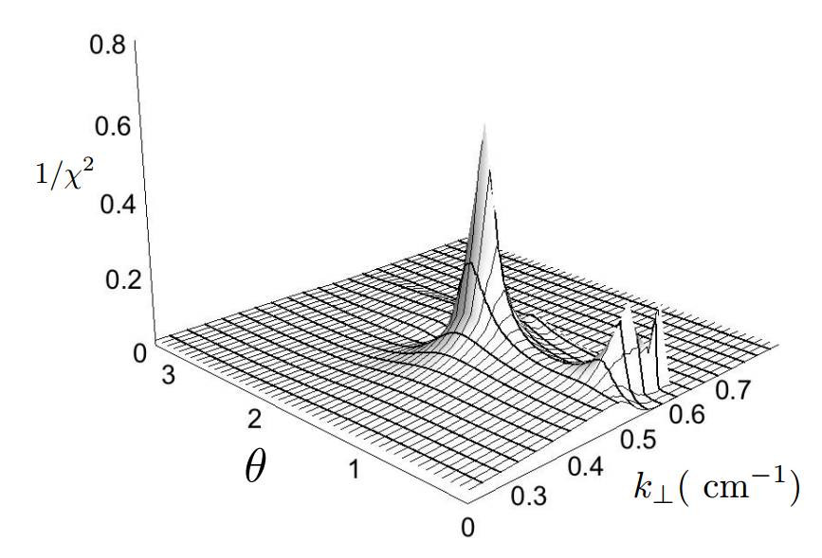
Sample $1/χ^{2}$ Plot
Location of peak indicates best fit parameters
Full width, half maximum gives error in fit parameters
Jorns Thesis 2012

